Slide 1
Transcranial Magnetic Stimulation
Presented to Access Mental Health Connecticut
Scott Berman MD, Wheeler Clinic

Slide 2
Transcranial Magnetic Stimulation
I will review:
Basic theory and mechanism of TMS
Efficacy Data for TMS
TMS in Adolescents
Advantages and Disadvantages of TMS
Risks and Side Effects
Choosing Candidates for TMS
How TMS is administered
Post TMS strategies

Slide 3
TMS: Mechanism of Action
TMS operates based on Faraday's law of electromagnetic induction which describes the process by which a changing magnetic field induces the flow of electric current in a nearby conductor preferentially standing at 90 degrees to the magnetic field.

Slide 4
Effects of TMS pulsed magnetic fields
▪ Pulsed magnetic fields induce a local electrical current in the superficial cortex
▪ Depolarizes neurons (change in charge differential across the membrane)
▪ Elicits an action potential (neuron fires)
▪ release of chemical neurotransmitters at synapse
▪ Propagation of signal to other brain regions and structures

Slide 5
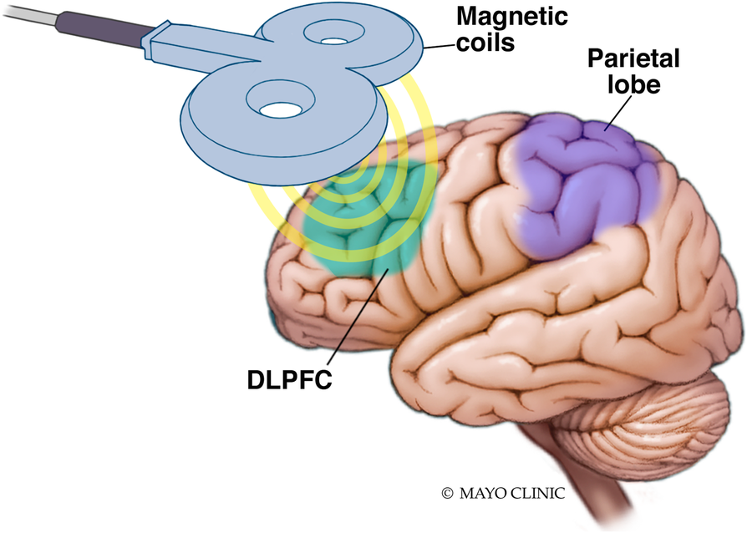

Slide 6
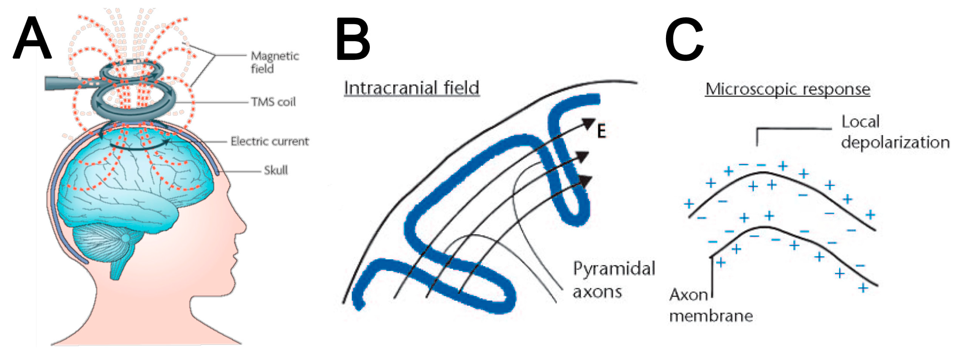
Magnetic field penetrates skull unimpeded (unlike electrical stimulus in ECT which meets resistance)

Slide 8
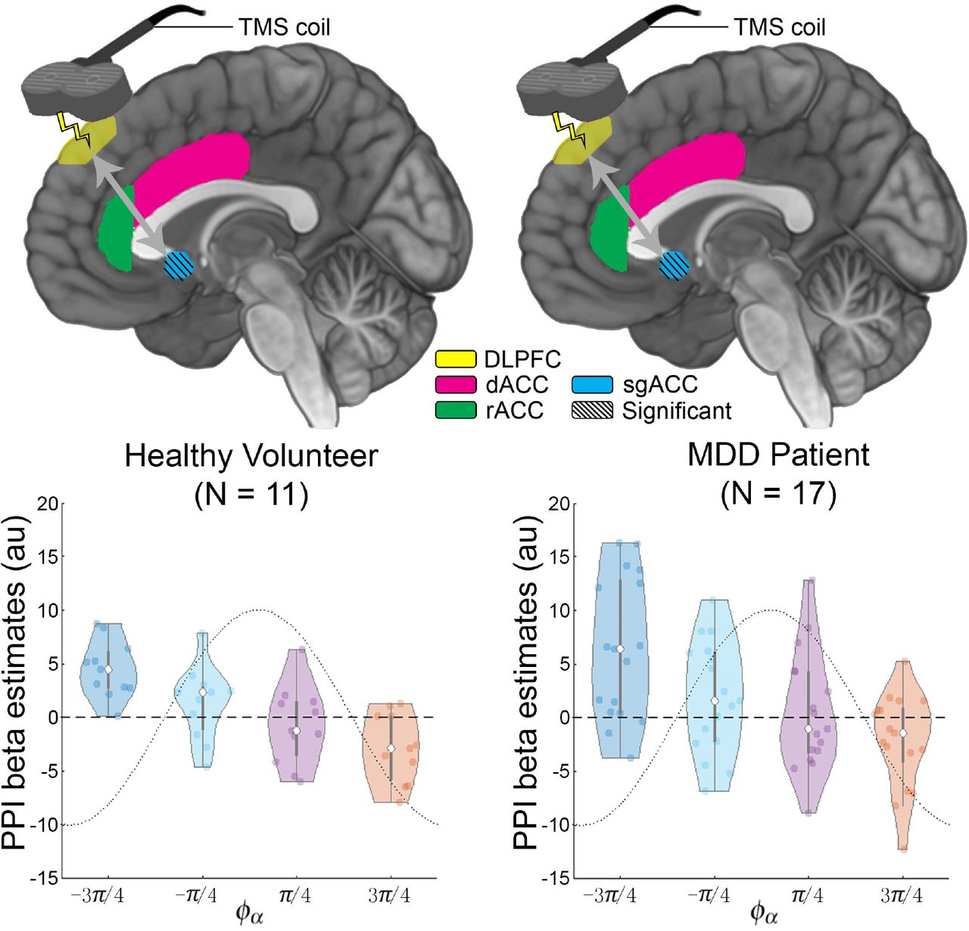

Slide 9
TMS: Downstream Effects
Changes in metabolism and blood flow
Changes in monoamine concentrations
Beta receptor and serotonin receptor modulation
Local gaba and glutamate effects
Effects on thyroid hormones and HPA axis
Neurogenesis gene induction, BDNF upregulation
Plasticity and long-term potentiation effects
Changes in gray matter and hippocampal volume
Changes in connectivity/neural circuitry, e.g. DLPFC-subgenual cingulate cortex

Slide 10
TMS: Why Do We Need It?

Slide 11
Major Depression: Terminology
Major Depressive Disorder: Depressed mood or loss of interest for 2 weeks or longer along with changes in sleep, self-esteem, energy, concentration, appetite, psychomotor activity, and suicidal ideation.
Response: 50% improvement as measured by PHQ9 or other standard depression rating scale
Remission: PHQ9 < 5 or similar by other rating scale

Slide 12
Major Depressive Disorder: Current Treatments
Current Treatment for Depression
Medications (chemical neuromodulation) - SSRIs, SNRIs, TCAs, MAOIs, lithium and other augmentation agents
Psychotherapy (behavioral neuromodulation) - CBT, DBT, ACT, Psychodynamic Therapy, Interpersonal Therapy, & Group Therapy
Neurostimulation (‘electrical’ neuromodulation) - ECT (Electroconvulsive Therapy), VNS (Vagal Nerve Stimulation); DBS (Deep Brain Stimulation), rTMS (repetitive Transcranial Magnetic Stimulation) , dTCS (direct Transcranial Stimulation)

Slide 13
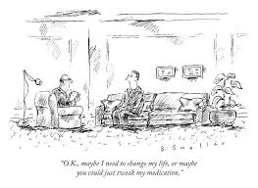

Slide 14
Antidepressant Medications
•Individual antidepressants get patients to remission about a third of the time.
• A recent meta-analysis shows that antidepressants have only a modest effect size of approximately 0.33
• With medication combinations and the development of pharmacogenomic testing we are likely improving these outcomes
• Unfortunately, many patients still do not respond to medications or do not tolerate the side effects associated with the medications
•STAR-D trial indicates that likelihood of success with medication goes DOWN with each successive trial.
10-30% of patients show partial or no response to antidepressants

Slide 16
TMS: How Effective Is It?

Slide 17
TMS: Efficacy Studies
Neurostar Study of TMS in 307 patients who had average of over 2 past med trials: 55% response, about 30% remission
Meta-analysis: Treatment with active TMS 5X more likely to remit than sham
The National Network of Depression Centers and the American Psychiatric Association's consensus recommendations also support the efficacy of rTMS, citing a pooled odds ratio for response of 3.3 and for remission of 3.3, with a number needed to treat (NNT) of 6 and 8, respectively.
rTMS is an effective treatment for MDD, with response rates ranging from approximately 25% to 54% and remission rates from 5.9% to 30%, depending on the study and measurement scales used.

Slide 18
TMS: Efficacy Studies
Neurostar Open Label Registry Study:
Response (58–83%) and remission (28–62%) rates were notably high across self-report and clinician-administered assessments.
Of 7759 participants, 5010 patients ITT sample, 3814 Completers
Pros: real world, not research setting
Cons: Open label, no sham, no data on patient characteristics

Slide 19
TMS: Efficacy Compared To Medication
rTMS as a Next Step in Antidepressant Nonresponders: A Randomized Comparison With Current Antidepressant Treatment Approaches (American Journal of Psychiatry 181:9 August 2024)
Patients with unipolar nonpsychotic depression (N=89) with an inadequate response to at least two treatment trials were randomized to treatment with rTMS or to a switch of antidepressants, both in combination with psychotherapy. Treatment duration was 8 weeks and consisted of either 25 high-frequency rTMS sessions to the left dorsolateral prefrontal cortex or a switch of antidepressant medication following the Dutch treatment algorithm.
rTMS resulted in a significantly larger reduction in depressive symptoms than medication, which was also reflected in higher response (37.5% vs. 14.6%) and remission (27.1% vs. 4.9%) rates.

Slide 20
TMS in Adolescents: Neurostar Study
Evidence of Safety and Efficacy in the Use of TMS as an Adjunctive Treatment for Adolescent Patients with MDD: Real‐World Data
1169 patients (ages 12-20), standard Neurostar protocol
PHQ 9 pre and post treatment were analyzed
The primary endpoint was met as 77.8% of the primary per protocol analysis population met the Individual Subject Success Criteria,
The mean change in PHQ‐9 scores from baseline to endpoint was ‐10.0 ± 6.6 and 30.0% attained remission of MDD symptoms defined as post‐treatment PHQ‐9 of <5.
Due to the smaller number of patients, aged 12 ‐ 14 years old (n=10), the final cleared indication for adolescents is age 15 – 21 years old.

Slide 21
TMS in Adolescents: Sham Control Study
Left prefrontal transcranial magnetic stimulation for treatment-resistant depression in adolescents: a double-blind, randomized, sham-controlled trial
103 patients ages 12-21, divided into 2 group (active and sham TMS)
Standard Neurostar treatments,30 over 6 weeks
Clinician rated scale (HAM-D)
Response: 41.7% active v. 36.4% sham
Remission: 29.2% active v. 29.0% sham
Although TMS treatment produced a clinically meaningful change in depressive symptom severity, this did not differ from sham treatment.

Slide 22
TMS in Adolescents: First Episode Depression
Adjunctive repetitive transcranial magnetic stimulation for adolescents with first-episode major depressive disorder: a meta-analysis, Sun, Frontiers in Psychiatry, 2023
A total of six RCTs involving 562 adolescents with FE-MDD were included.
Intervention: active rTMS plus antidepressants. Comparison: antidepressants plus sham rTMS or antidepressant monotherapy.
Findings:
(1) adjunctive rTMS was superior in improving depressive symptoms over the control group;
(2) adolescents with FE-MDD treated with rTMS had a significantly greater response and remission over the control group, suggesting that rTMS may have beneficial effects for adolescents with FE-MDD;
(3) rTMS appeared to be safe and tolerable as an adjunct treatment for adolescents with FE-MDD;
(4) adjunctive rTMS appears to be effective in improving neurocognitive function in adolescents with FE-MDD.

Slide 23
TMS in Adolescents: First Episode Drug Naïve Depression
Among the two RCTs (66.7%, 2/3) examining the effects of LF-rTMS on study-defined response and remission and cognitive function, active LF-rTMS was more efficacious than sham LF-rTMS in terms of study-defined response rate and cognitive function (all p < 0.05) but not regarding study-defined remission rate (all p > 0.05).
These findings preliminarily found that LF-rTMS could benefit children and adolescents with FEDN MDD in a relatively safe manner, although further studies are warranted.

Slide 24
TMS in Adolescents : Safety
AACAP (April 2024): Some studies suggest that TMS is safe and effective in younger adolescents with depression, especially when medication and therapy do not sufficiently help, but further research is needed to confirm its safety and efficacy in this age group.
AAP: no current position statement
APA/NNDC 2018: However, there is evidence of safe therapeutic use and clinical benefit of rTMS in adolescents with mood disorders,^{45,46} women with perinatal depression,⁴⁷ . . . but at present, there is insufficient evidence to support routine clinical rTMS use in these populations.
Safety: rTMS is generally considered safe for children and adolescents. A systematic review by Allen et al. found that the risk of adverse events (AEs) in pediatric populations is similar to that in adults, with an overall low incidence of serious AEs such as seizures. Another study by Zewdie et al. reported no serious adverse events in a large cohort of children undergoing various forms of non-invasive brain stimulation, including rTMS. Additionally, a systematic review by Majumder et al. indicated that rTMS is well-tolerated with minor and mostly self-limited side effects.^{[1-3]}
Side Effects: Common side effects of rTMS in children and adolescents include transient headaches, dizziness, and discomfort at the stimulation site. Wallman et al. reported that drowsiness and lethargy were common, particularly in the initial weeks of treatment, but these symptoms generally decreased over time. Zewdie et al. also noted that headaches were more common in children with perinatal stroke but were mild and self-limiting. A meta-analysis by Huashuang et al. found that the most common side effects in children with autism spectrum disorder undergoing TMS were headaches, facial discomfort, and irritability, all of which were mild and transient.^{[2][4-5]}
BUT: Only approved in 2023, long term data on large number of adolescents not yet available.

Slide 25
TMS: Patient Selection

Slide 26
TMS: Candidates
Major Depressive Disorder, Recurrent, Moderate to Severe
NOT approved for Bipolar Depression
Not approved for Depression with Psychotic Features
Symptomatic after medication trials or intolerant of medications

Slide 27
TMS: Candidates: Psychiatric Contraindications
Bipolar Disorder
Psychosis (consider ECT)
Catatonia (consider ECT)
Acutely Suicidal (consider ECT)
Active Substance Use Disorder

Slide 28
TMS: Candidates: Medical Contraindications
ABSOLUTE CONTRAINDICATION: metal implants/devices in head or neck within 30 cm (1 foot) of coil
Relative Contraindications:
▪ Deep Brain Stimulator
▪ Aneurysm clips or coils
Cochlear implants
▪ Intracranial Stents
▪ Vagus Nerve Stimulators
Dental fillings/bridges/jewelry usually fine

Slide 29
TMS Candidates: Medical Contraindications
SEIZURE DISORDER (at this time we do not accept patients with a history of seizures even if they are on anticonvulsants).
Brain tumor, major stroke, meningitis
Severe head trauma
Heavy alcohol use, stimulant use
Use of medications that significantly lower seizure threshold
Infection
Lack of sleep

Slide 30
TMS Candidates: Insurance
Covered by
Medicaid/Husky
Medicare
Private Insurance
Each has different inclusion criteria: in general 2-4 documented adequate med trials with either no response/intolerance AND a trial of evidence based psychotherapy

Slide 31
TMS: Advantages and Disadvantages

Slide 32
TMS: Advantages
Unlike medications, TMS does not cause systemic side effects
▪ Unlike medications, which are prone to errors and non-adherence, TMS is an observed procedure during which proper administration is supervised
▪ Unlike ECT, TMS is an office-based procedure that requires no sedation, anesthesia, hospitalization or recovery time
▪ Unlike ECT, there are no known cognitive side effects with TMS ▪ Unlike VNS, TMS is non-invasive
▪ TMS has proven to be effective in treatment resistant depression (TRD) for patients who have not responded to several medication trials

Slide 33
TMS: Disadvantages

Slide 34
TMS: Side Effects & Risks

Slide 35
TMS Risks: Seizures
Risk is < .1% or about 1:30,000 treatments (more recent data 1:60,000 treatments)
Risk is comparable to risk of seizure from antidepressant medications
All reported TMS related seizures have:
a) occurred during the session,
b) are self limited
c) have no sequelae
d) no progression to seizure disorder.

Slide 36
TMS Risks: Treatment Emergent Suicidal Ideation
Treatment Emergent Suicidal Ideation
Occurs about 0.6% of the time, and less often than with sham treatment
This can also occur with antidepressant medications, most often in youth/teens

Slide 37
TMS Risks: Induction of Mania
Overall occurred .81%
Patients with MDD .34%
Patients with Bipolar Depression 3.1%
We DO NOT currently accept patients with bipolar disorder regardless of whether they are currently in depressed phase. There is active research on TMS for Bipolar Depression

Slide 38
TMS Risks: Hearing Loss
Rare but has been reported.
Not reported in patients with proper protection
RECOMMENDATION: Patients, visitors, and technicians should be required to wear earplugs that provide a minimum of 30 dB of protection.

Slide 39
TMS: Side Effects
Application site discomfort/pain
▪ Headache (no increase in migraine frequency for pre-existing migraine, there is a single pulse TMS device to treat migraine)
▪ Referred (eye, tooth, jaw) discomfort/pain
▪ Insomnia
▪ Anxiety
Side effects tend to go down over the course of treatment

Slide 40
TMS: Administration

Slide 41
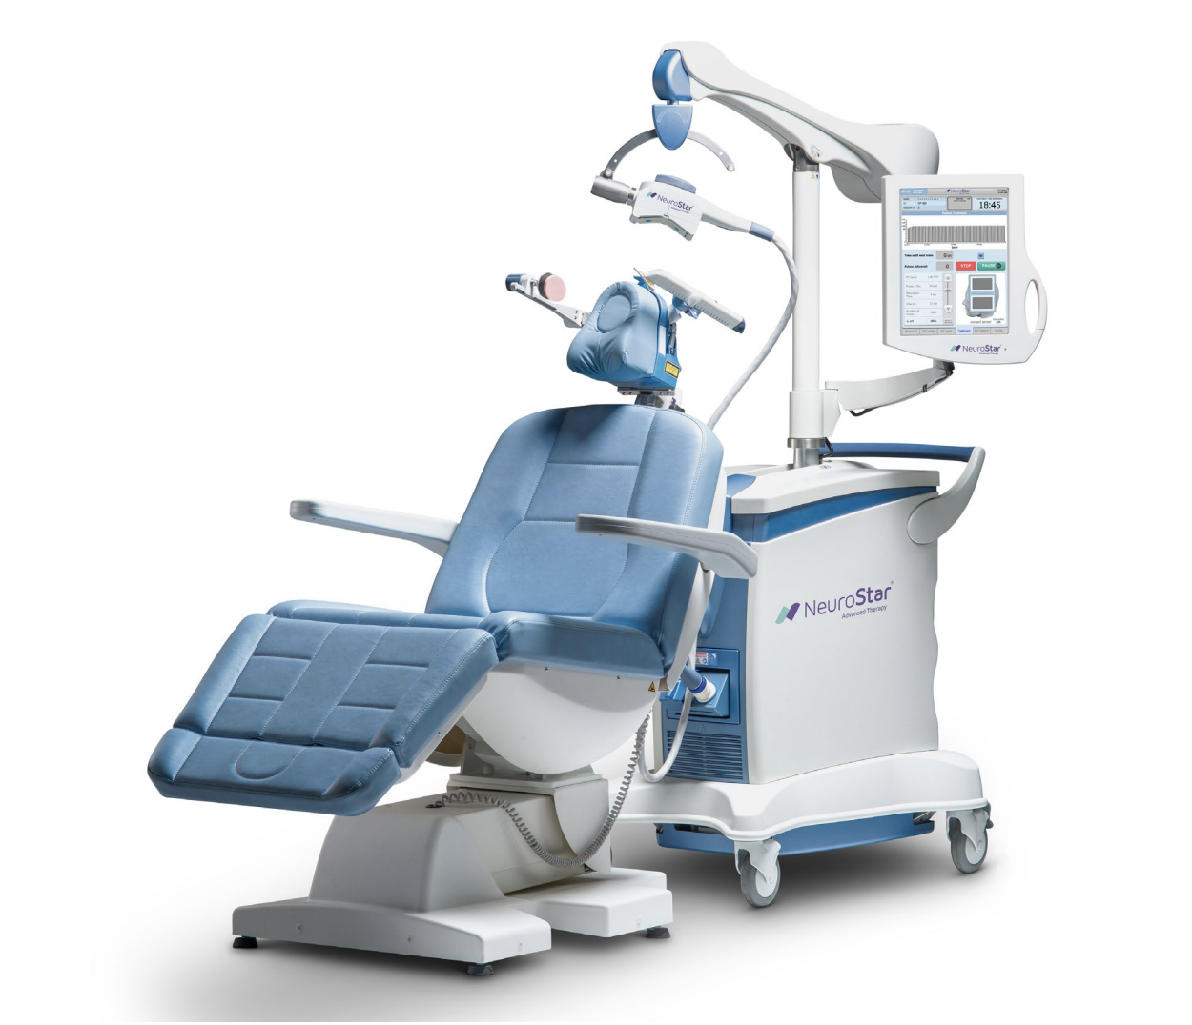

Slide 43
TMS: Administration: Mapping
Patient is seated comfortably in chair, settings recorded (can’t move head from settings subsequently)
Coil placed over left Motor Strip, single pulses delivered at increasing intensity until right hand twitch elicited. This is the MT (Motor Threshold).
Coil moved until ite of maximum intensity is found at the set MT
Coil moved until just thumb/forefinger twitch is isolated
Computer delivered single twitches to calculate minimal MT (Fast MT in Neurostar)
Coil moved anteriorly 5.5 cm to approximate location of DLPFC
Treatment parameters stored in computer
Procedure takes about 30 minutes or less

Slide 44
TMS: Administration of Protocol
Parameters are set by computer in Neurostar (or can be altered by operator).
Typical parameters include
3000 pulses at
10 Hz frequency (excitatory)
4 second duration
11-25 second InterTrain Interval (rest periods to reduce seizure risk)
MT 70-80% to start target with a goal of 120% by session 5. (reduced efficacy with < 100% MT)
Session duration of 18-35 minutes
36 sessions total
PHQ9 Pre-treatment, weekly, and at end of last session
Patient will hear a loud clicking during pulse intervals and feel “like a woodpecker” hitting their head but this is nerve stimulus, no moving parts in magnet. Discomfort is attenuated over time. Coil angles can be adjusted for discomfort or for twitching (do NOT want motor twitches)

Slide 45
TMS: After Treatment
In summary, the relapse rate over one year after effective TMS treatment in depressed patients ranges from approximately 24.2% to 53.7%, depending on the maintenance strategy and patient characteristics. Maintenance TMS can significantly reduce the risk of relapse and sustain antidepressant effects.
No current approved maintenance protocol
Continue medications that seem efficacious.
There is a chance of relapse in the first twelve months after TMS
If the patient had a robust first response to TMS then retreatment or monthly maintenance treatment has a good chance of being effective (compared to no data for retreatment with previously effective medications)

Slide 46
TMS: Maintenance
Monthly maintenance session may offer some benefit in prolonging antidepressant effect.
Evidence for weekly or twice weekly maintenance over 1 year.
Tapering schedule of maintenance (twice weekly for 1 month, once weekly for 1 month, then once every 2 weeks for 9 months effective comparable to pharmacotherapy
As needed reinstitution effective in patients who initially responded

Slide 47
TMS: Post Treatment Options
Maintenance TMS: Maintenance TMS has been shown to significantly reduce relapse rates. Haesebaert et al. found that maintenance TMS administered twice per week for 1 month, once per week for 2 months, and once every 2 weeks for 9 months resulted in a 40% non-relapse rate over 12 months. Richieri et al. demonstrated that maintenance TMS was associated with a significantly lower relapse rate (37.8%) compared to no additional TMS treatment (81.8%) over a 20-week period. ^{[1-2]}
Continued Medication: Continued pharmacotherapy, such as venlafaxine, has also been effective in maintaining remission. Haesebaert et al. reported a 45.1% non-relapse rate in patients maintained on venlafaxine at doses of 150 or 225 mg/day over 12 months, which was comparable to the maintenance TMS group.^{[1]}
No Further Treatment: Patients who do not receive any further treatment after initial TMS therapy have higher relapse rates. Philip et al. found that patients under observation only (no scheduled maintenance TMS) had a nonsignificantly shorter time to relapse compared to those receiving scheduled monthly TMS sessions. Richieri et al. also reported a higher relapse rate (81.8%) in patients without maintenance TMS.^{[2-3]}
In summary, maintenance TMS and continued medication both show similar efficacy in preventing relapse, with non-relapse rates around 40-45% over 12 months. No further treatment is associated with significantly higher relapse rates.

Slide 48
Summary
TMS for adolescents 15-21 is now FDA approved on the Neurostar machine
There is promising data supporting it’s efficacy but the data is mixed and study populations are not consistent (first episode, drug naïve, multiple drug resistant)
Short term (during treatment) safety/tolerability data is good.
Long term safety / effect data is not yet available
APA is cautious and AAP not yet weighed in
Need to weigh decision to use TMS in adolescents against --risks/side effects of medications
--risks/consequences of untreated depression
Need to have shared decision making with patients and families

Slide 49
More information
List other training sessions
List books, articles, and online sources
List consulting services and other sources

Slide 50
