Slide 1
Borderline Personality Disorder in Adolescence
Understanding and Addressing BPD in
the Adolescent Population
Milind Kale, M.D.

Slide 2
Table of Contents
1. Definition and Overview
2. Symptoms and Diagnostic Criteria
3. Etiology and Contributing Factors
4. Diagnosis in Adolescents
5. Comorbidities
6. Treatment Modalities
7. Overview of DBT
8. Conclusion and Q&A

Slide 3
Basic Definitions
First essential to define what is a personality disorder:
Personality is a set of enduring behavioral and mental traits
Disorder occurs with enduring maladaptive patterns of behavior, cognition, and inner experience exhibited in many contexts and deviating from an individual’s cultural norms
Notes:
Personality, defined psychologically, is the set of enduring behavioral and mental traits distinguishing individuals.
PDs are enduring maladaptive patterns of behavior, cognition, and inner experience, exhibited across many contexts and deviating from those accepted by the individual's culture.
Positive and Negative Urgency
lack of premeditation, (2) sensation seeking, (3) lack of perseverance, and (4) urgency. Rash action when exposed to potential rewards
Negative Urgency: Aversive emotional states

Slide 4
What is BPD?
Personality structure primarily composed of instability and impulsivity
Driven by fear of abandonment
Extreme Instability: Relationships, Behaviors, Emotions, Sense of Self
Impulsivity: Suicide Attempts, Self Injurious Behavior, Substance Abuse, Sexual Promiscuity, Eating Behavior
Multiple factors including clinical underdiagnosis, stigma against BPD, and difficulty in finding DBT clinicians create unique challenges to proper treatment
Notes:
Personality, defined psychologically, is the set of enduring behavioral and mental traits distinguishing individuals.
PDs are enduring maladaptive patterns of behavior, cognition, and inner experience, exhibited across many contexts and deviating from those accepted by the individual's culture.
Positive and Negative Urgency
lack of premeditation, (2) sensation seeking, (3) lack of perseverance, and (4) urgency. Rash action when exposed to potential rewards
Negative Urgency: Aversive emotional states

Slide 5
Statistical Context
Prevalence among Adolescents: 3%
Suicidal Adolescents in the ER: 78%
Outpatient Clinic: 11%
Duration Criteria: One Year
Notes:
Suicide is the second leading cause of death in 10 to 14-year-olds.
Prevalence of STB’s is 7.5%
5 to 11-year-old 43% of STB-focused ER Visits
Preadolescent Children’s Lifetime prevalence is 2.6% for SA, and STB is 15.1 % and SITB is 6.3%

Slide 6
Statistical Context
Suicide Is The Second Leading Cause Of Death In 10–14-Year-Old
Prevalence of STB’s is 7.5%
5 to 11-year-old 43% of STB-focused ER Visits
Preadolescent Children’s Lifetime prevalence is 2.6% for SA, and STB is 15.1 % and SITB is 6.3%
Notes:
STB: Suicidal Thoughts and Behaviors
SITB: Self-Injurious Thoughts and Behaviors without Intent

Slide 7
Nine Traits of BPD
Intense Fear of Abandonment | Extreme anger, sadness if confronted with the possibility of feeling abandoned
Unstable And Intense Interpersonal Relationships | “Black and white” perceptions of others, people are the best person ever or the worst (splitting), perceptions can change often and based on seemingly minor slights
Identity Disturbance (Who Am I) | Constantly changing self-perception, difficulty articulating personal perspectives or feelings
Impulsivity | Little regard for personal safety: reckless driving, substance use, frequent sexual encounters
Suicidal Thoughts Or Acts | Physical pain distracting momentarily from emotional pain
Affective Instability (Emotional Regulation) | Often feel that emotions control their behavior involuntarily, affect changes within minutes to hours
Chronic Feelings Of Emptiness | Persistent dysthymic mood, feels that suffering cannot be understood by others
Inappropriate Displays Of Anger Followed By Shame And Guilt | Contributes to instability in interpersonal relationships
Transient Psychotic Symptoms (Dissociative States) | Dissociation can be so severe that they seem internally preoccupied
Notes:
Changing hair colors, styles, names
Depersonalization and Derealization
Self Harm, which includes SA and NSSI, and NS self-poisoning is the strongest predictor of suicide,

Slide 8
Comorbidities
Mood Disorder
Anxiety Disorder
PTSD
Notes:
Vast majority of people with BPD have trauma history
Other comorbidities:
Sleep Disorder
Substance Use Disorder
ADHD
Eating Disorder
Often many meds tried with little to no effect

Slide 9
Etiology of BPD
High emotional reactivity to perceived threats as a method of survival
Development of mistrustful view of world based on insecure attachment, perceiving others as untrustworthy, rejecting emotional stability
Communication of private emotional experiences met by erratic, inappropriate, and extreme responses by caregivers
Emotional vulnerability often punished and/or trivialized
Repeated, often severe trauma and/or invalidating environment
As child develops, mental energy spent on basic survival and protection, less focus on forming stable and secure emotional landscape
Maladaptive behaviors (excessive risk taking, unstable relationships, self harm, etc)
Notes:
TRAUMA REWIRES THE BRAIN
Because ecological, biological, and psychological resources are limited, there are distinct strategies that have been selected underlying individual differences in allocation for the life activities of development, survival, and reproduction
These strategies that organize individual differences in organisms have been termed life history strategies and involve trade-offs between problems such as current vs. future reproduction, offspring quality vs. offspring quantity, and "mating" vs. parental effort. The pattern of behavioral and biological characteristics of life histories can be placed within what is known as the fast-slow continuum. This continuum describes and integrates the organization of metabolic, hormonal, behavioral, and personality characteristics and is organized according to the demands of the environment and the survival strategy favored by natural selection
LHT proposes that emotional and behavioral development emerges as a result of adaptation to contextual contingencies, which allows the survival of the individual at the moment in their history, dissuading ideas related to causes underlying the symptoms of a disorder. It breaks with the stigmatizing and victimizing role of mental illness typical of the medical model.
fast life strategies improve the odds of survival in adverse environments . It is common to find that individuals diagnosed with BPD grew up in unpredictable and hostile environments
Wrong in description and analysis of her own experiences and attribution of experiences to socially unacceptable or personality traits.

Slide 10
Life History Theory
“Fast and Furious”
“Slow”
COGNITION/ EMOTIONS | LOW EMPATHY Heightened threat sensitivity | High empathy Low Threat Sensitivity
Neuropsychology | Low tolerance of Frustration Poor Executive Control | High Frustration Tolerance Good Executive Control
Personality | Neuroticism ^ Agreeableness Conscientiousness | Neuroticism Agreeableness ^ Conscientiousness ^
Temperament & Character | Novelty seeking ^ Harm avoidance Risk Proneness ^ | Novelty seeking Harm avoidance ^ Risk Proneness
Interpersonal Behavioral | Opportunistic Low Parenting effort Unstable Intimate relationship | Altruistic High Parenting effort Stable Intimate relationship
Stress Physiology | High Cortisol | Low Cortisol
Other | Early Sexual Maturation | Late Sexual Maturation
Notes:
High-Stress Responsivity Promotes a Fast LHS in Dangerous and Unpredictable Contexts increases vigilance to threat and down-regulates sensitivity to social feedback
Heightened sensitivity to emotional cues potentially signaling rejection or abandonment

Slide 11
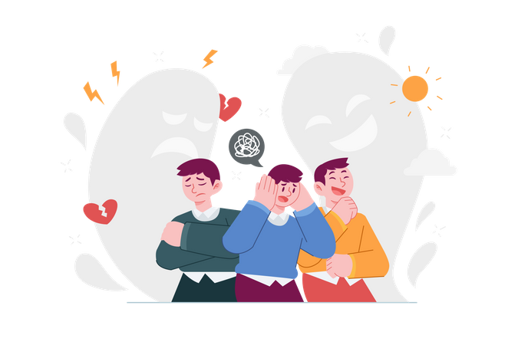
Diagnosis
MacLean Screening Instrument for BPD
MacLean SIBPD.pdf
The Abbreviated Diagnostic Interview For Borderlines (Ab-dib) is a 26-item self-report screening instrument for BPD
The Brief (11-item) Borderline Personality Features Scale For Children (BPFSC-11) is a shortened version of the Original BPFSC
Differentials to Consider:
Bipolar Disorder
Other Cluster B Personality Disorders
Mood Disorders
ADHD
PTSD

Slide 12
Importance of Diagnosis in Adolescence
Adolescence Characterized by:
Identity Disturbance
Intensity and functioning of behaviors
Positive and negative urgency and impacts on behavior
Reasons to diagnose:
Adolescence is a key period for the development and manifestation of personality disorders
Early diagnosis→ early intervention→ improved outcomes
Reducing stigma
Increase validation through understanding and education
Opportunities to address family dynamics and provide guidance for improved communication and safety
Notes:
Positive and Negative Urgency
lack of premeditation, (2) sensation seeking, (3) lack of perseverance, and (4) urgency. Rash action when exposed to potential rewards
Negative Urgency: Aversive emotional states

Slide 13
Resouces
ACCESS Mental Health Connecticut offers real-time psychiatric consultation to medical providers when patients present with mental health and substance use concerns. It is accessible to you and your patients, regardless of insurance. Carelon Behavioral Health’s program supports providers working with youth and perinatal women through community-focused expertise and resource coordination.​
ACCESS Mental Health for Youth
Pediatric and Family Care Providers
Youth up to age 22, regardless of insurance

Slide 14
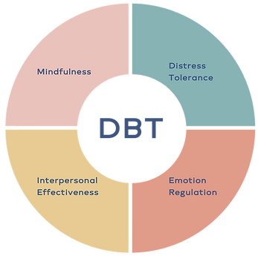
Treatment Modalities
Essential to treat comorbidities and use lowest number and dose of medications that is effective.
Evidence Based Psychotherapies:
Dialectical Behavioral Therapy (DBT) has greatest evidence base, accepting two seemingly opposed truths
Dialectical Dimensions:
Unrelenting Crises And Inhibited Grieving
Emotional Vulnerability And Self Invalidation
Active Passivity And Apparent Competence
Mentalization-Based Treatments (MBT)
Schema Focused Therapy (SFT)
Transference Focused Psychotherapy (TFT)
Systems Training For Emotional Predictability and Problem-solving (STEPPS)
Notes:
Repetitive trauma and loss with an inability to fully experience and integrate or resolve

Slide 15
Citations
Images:
https://www.verywellmind.com/borderline-personality-disorder-4157266
https://www.vectorstock.com/royalty-free-vector/personality-disorder-concept-vector-42478457
https://cdni.iconscout.com/illustration/premium/thumb/personality-disorder-5253961-4391413.png
https://static.wixstatic.com/media/df5ee2_7524fc3f8d6b4d8f84822e1bca3f3d6c~mv2.png/v1/fill/w_347,h_345,al_c,q_85,usm_0.66_1.00_0.01,enc_auto/DBT.png
Citations:
Brüne, M. (2016). Borderline Personality Disorder: Why ‘fast and furious’? Evolution, Medicine, and Public Health, (2016) 52-66. doi:10.1093/emph/eow002
Berk, M., et al. (2024). Remission, recovery, and relapse. Journal of the American Academy of Child & Adolescent Psychiatry, 63(9), September 2024.
Ayer, L., et al. (2024). Emotional experiences and outcomes. Journal of the American Academy of Child & Adolescent Psychiatry, 63(9), September 2024.

