Slide 1
Fundamentals of Emergency Psychiatry
Pam Hoffman, MD
12/1/2022

Slide 2
Overview
When do psychiatrists worry: Overview of psychiatric emergencies
When should I worry: Discussion of crisis examples that may warrant emergency behavioral health evaluation
What happens then: Process in the Emergency room when kids present
What do I do: What a Pediatrician’s role can be for patients with behavioral health crises

Slide 3
Psychiatric Emergencies
 |  | Neuroleptic malignant syndrome | Serotonin syndrome
Precipitated By |  | Dopamine Antagonists | Serotonergic Agents
Onset |  | Variable, 1-3 days | Variable, < 12 hours
Identical Features | Vital Signs | Hypertension Tachycardia Tachypnoea Hyperthermia (> 40°C) | Hypertension Tachycardia Tachypnoea Hyperthermia (> 40°C)
 | Mucosa | Hypersalivation | Hypersalivation
Overlapping Features | Skin | Diaphoresis Pallor | Diaphoresis
 | Mental Status | Variable, stupor, coma, alert | Variable, agitation, coma
 | Muscles | 'Lead-pipe' rigidity in all muscle groups | Increased tone, especially in lower extremities
Distinct Features | Reflexes | Hyporeflexia | Hyperreflexia Clonus (unless masked by increased muscle tone)
 | Pupils | Normal | Dilated
 | Bowel Sounds | Normal or decreased | Hyperactive
From <https://www.medsafe.govt.nz/profs/PUArticles/Dec2012Neuroleptic.htm>

Slide 4
Emergencies of Suicidality
Passive Suicidality
Thoughts of death or dying
Thoughts that life isn’t worth it
Active Suicidality:
Suicidal ideation
Suicidal intent – wish to act on the thought
Suicidal plan – specific (attainable) action to implement intentions
Efforts to further plan

Slide 5
How to ask these questions
Columbia Suicide Severity Rating Scale:
or
ASQ – Ask Suicide Screening Questions – Suicide Risk Screening Tool
Outpatient Primary Care/Specialty Clinics
Brief Suicide Safety Assessment Guide (PDF | HTML)
Brief Suicide Safety Assessment Worksheet (PDF | HTML)
ASQ Suicide Risk Screening Tool (PDF | HTML)
Outpatient Suicide Risk Clinical Pathway (PDF | HTML)
Mental Health Resources (PDF | HTML)
Script for Nursing Staff (PDF | HTML)
Parent/Guardian Flyer (PDF | HTML)
Links to Videos (PDF | HTML)
Information Sheet (PDF | HTML)

Slide 6
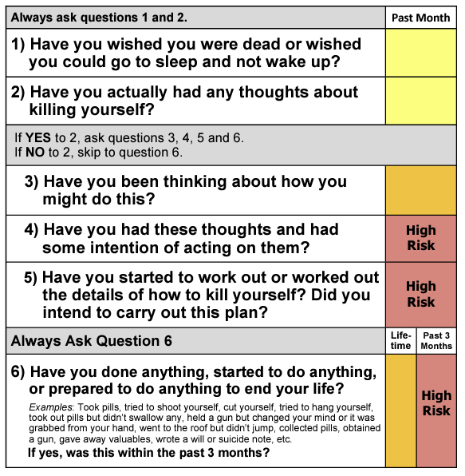
CSSRS:
https://cssrs.columbia.edu/the-columbia-scale-c-ssrs/cssrs-for-communities-and-healthcare/#filter=.healthcare.english

Slide 7
Homicidal ideation, Aggression
Homicidal ideation:
Thoughts of killing person/s; (identified)
Intent/plan: threats or have they furthered their plan
Is it feasible? (e.g. “I’m going to buy a gun and shoot you” said by a 7yo)
Is it conditional? (e.g. “If they fail me on this test, I’m going to kill my teacher”)
Aggression:
Violence toward property
Violence toward people

Slide 8
How to ask these questions
Modified Overt Aggression Scale (MOAS)*
Over a week look at: (weighted categories)
Verbal Aggression
Aggression against property
Aggression against self
Physical aggression

Slide 9
Psychosis and Perceptual disturbances
Hallucinations:
Auditory
Visual
Tactile*
Delusions:
Paranoia
Not to be confused by:
Interior monologue/negative thoughts

Slide 10
How to ask these questions
Brief Psychiatric Rating Scale for Children
Concise scale looking at:
Behavior Problems (Items 1-3)
Depression (Items 4-6)
Thinking Disturbance (Items 7-9)
Peculiar fantasies
Delusions
hallucinations
Psychomotor Excitation (Items 10-12)
Withdrawal (Items 13-15)
Anxiety (Items 16-18)
Organicity (Items 19-21)

Slide 11
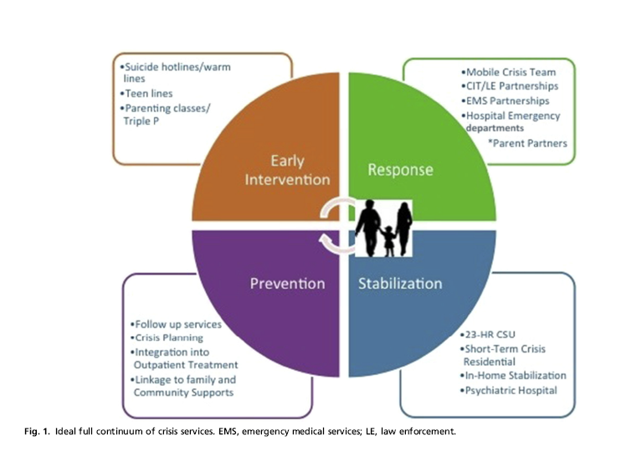
Ideal Continuum of Crisis Services

Slide 12
Emergency Room evaluation
Triage in the ED by nursing
Medical evaluation by Pediatric Emergency Medicine Team
Behavioral Health consultation
Social Work assessment on weekdays
Psychiatric fellow assessment on weekends
Crisis evaluation (not a complete psychiatric assessment)
Disposition planning
Discharge with referrals
Admission to inpatient

Slide 13
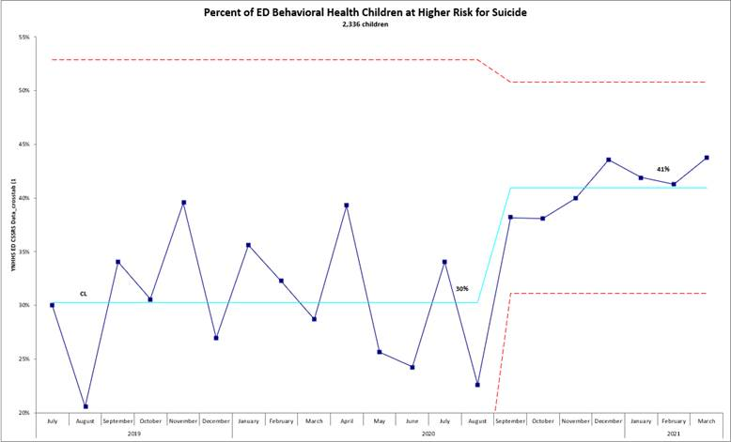
Emergency Psychiatry
Notes:
Practical advice:
reach out as soon as possible.
keep your appointments
ask for help with telehealth technology;

Slide 14
Emergency Room process wait times
Triage in the ED (minutes – hours)
Medical evaluation (minutes – hours)
Behavioral Health consultation (can take up to 1 day)
Disposition planning
Discharge with referrals
IOP referral – can take weeks
IICAPS – can take weeks
Outpatient referral for therapy – can take months
Outpatient referral for med management – can take months
211 – can be same day/next day
Admission to inpatient (can take up to 10 days)

Slide 15
What Can Pediatricians Do?
A LOT!
Continue your relationship with them
Collaborate with providers (therapists, psychiatrists, school counselors)
Safety plan with the family
Safety-proof home recommendations for family (AACAP Facts for Families)
211 referrals

Slide 16
Additional References
Emergency Psychiatry review: https://www.sciencedirect.com/journal/child-and-adolescent-psychiatric-clinics-of-north-america/vol/27/issue/3
CSSRS: https://cssrs.columbia.edu/wp-content/uploads/C-SSRS_Pediatric-SLC_11.14.16.pdf
ASQ: https://www.nimh.nih.gov/sites/default/files/documents/research/research-conducted-at-nimh/asq-toolkit-materials/asq-tool/screening_tool_asq_nimh_toolkit.pdf
Notes:
https://www.ctpublic.org/show/where-we-live/2022-07-20/yale-uconn-expanding-telehealth-services-in-response-to-strong-patient-demand

