Slide 1
Suicide Risk Assessment in Youth: The Art of Interview
Clinical Conversations with ACCESS Mental Health
Jensi George, MD
Child & Adolescent Psychiatrist IOL/HH

Slide 2
Objectives
Review epidemiology of suicide in pediatric population
Review screening tools and risk/protective factors
Explore the clinical interview of risk assessment & how to integrate it into primary care practice

Slide 3
General Statistics (CDC)
2nd leading cause of death among youth aged 10–14 and 3rd leading cause in youth aged 15-19 in the United States
Following a steady decline since 1999, suicide rates in this age group (10-19 yo) increased 47% between 2010 and 2019 (from 4.2 to 6.6 per 100,000)
According to the 2019 Youth Risk Behavior Survey (YRBS):
1 in 5 youth seriously considered suicide
1 out of 11 youth reported they attempted suicide at least once in the prior 12 months.

Slide 4
Gender Statistics

Slide 5
Notable Changes In Trends
Suicide rates among youth aged 10–14 years increased 100% between 2010 and 2019 (from 1.3 to 2.6 per 100,000), compared to a 40% increase in youth aged 15–19 years (from 7.5 to 10.5 per 100,000)
M > F → Recent data reveals a narrowing gap
Most common suicide method: firearms versus hanging/suffocation
Most notable increase occurred in females aged 10–14 years, with rates more than doubling from 0.66 per 100,000 in 2010 to 1.4 per 100,000 in 2019

Slide 6
Race Statistics
American Indian/Alaska Native (AI/AN) youth in the United States have the highest rates of suicide
In 2019, suicide rate of AI/AN youth aged 10–19 years (23.6 per 100,000) was nearly 3x the rate for White youth (7.7 per 100,000) and over 4x higher than rates for Black, Asian/ Pacific Islander, and Hispanic youth
An analysis by Bridge et al. (2018) found the suicide rate in children younger than 13 years to be roughly 2x higher for Black children compared with White children

Slide 7
Screening Tools

Slide 8
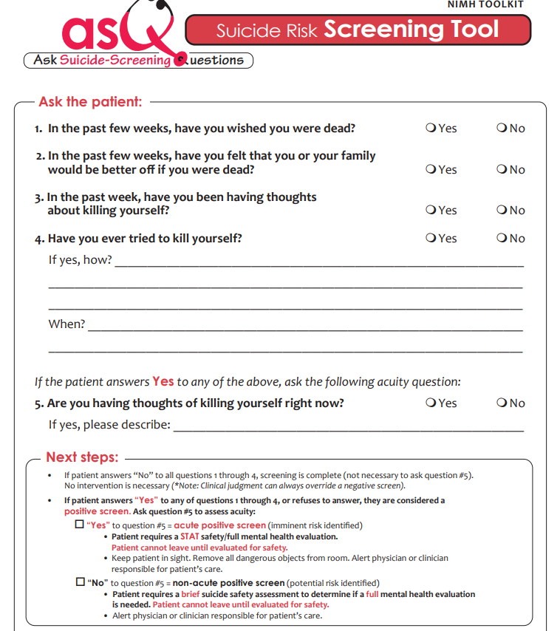
Ask Suicide-Screening Questions

Slide 9
Patient Safety Screener

Slide 10
Columbia-Suicide Severity Rating Scale (C-SSRS)

Slide 11
Risk Factors
Individual Risk Factors Previous suicide attempt History of depression and other mental illnesses Impulsive or aggressive tendencies Substance misuse Trauma Sense of hopelessness Sexual and gender minority | Relationship Risk Factors Bullying Family/loved one’s history of suicide Loss of relationships High conflict or violent relationships Social isolation
Community Risk Factors Lack of access to healthcare Suicide cluster in the community Stress of acculturation Community violence Historical trauma Discrimination | Societal Risk Factors Stigma associated with help-seeking and mental illness Easy access to lethal means of suicide among people at risk Unsafe media portrayals of suicide

Slide 12
Protective Factors
Individual Protective Factors Effective coping and problem-solving skills Reasons for living (for example, family, friends, pets, etc.) Strong sense of cultural identity Future oriented | Relationship Protective Factors Support from partners, friends, and family Feeling connected to others
Community Protective Factors Feeling connected to school, community, and other social institutions Availability of consistent and high quality physical and behavioral healthcare | Societal Protective Factors Reduced access to lethal means of suicide among people at risk Cultural, religious, or moral objections to suicide

Slide 13
Challenges in Primary Care Setting
Limited predictive value of screening tools
Having to juggle significant time demands
Challenge of finding effective ways to create a compassionate and caring assessment environment that will increase the likelihood of accurate self-report, increase self-disclosure during the clinical interview, and help develop a strong therapeutic alliance

Slide 14
Solution

Slide 15
Dynamic Nature of Suicidal Ideation
Standardized suicide risk instruments are not well-suited to assess the natural temporal dynamics of suicidal thinking
Suicidal ideation and motivation to die ebbs and flows, sometimes very rapidly; consider and explore the possibility of cycling when active SI denied in the moment:
“Some people find that their suicidal thoughts and desire to die come and go, changing rapidly from minute to minute, hour to hour, or day to day? Does this describe you? Can you describe any pattern(s) you've noticed in your suicidal thinking? What is an average day or week like for you?”
“Since you don't report any active suicidal thoughts, if agreeable, let's focus on the last time you thought about suicide and felt motivated to die. When was the last time you thought about suicide? Let's focus on that episode to see if there's any identifiable pattern to how your thoughts about suicide and motivation to die come and go.”

Slide 16
Assessing Constructs Other Than Suicidal Ideation
Perceived burdensomeness
Do you ever feel like a burden on your loved ones, or that they'd be better off if you were dead?
Acquired capability (an observed variable that can be inferred from past behavior, prior trauma, abuse, and/or repeated exposure to death and violence)
Have you ever done things to harm yourself, with no intention of dying, like cutting, burning, or hitting?
Have you had any experiences you would consider traumatic, particularly those involving exposure to violence or death?
Identity-based hopelessness
Do you ever feel completely unworthy of love or that there is nothing redeeming about you?
Do you ever feel like your emotional pain is unbearable?
Do you ever feel like your problems are unsolvable?

Slide 17
Assessing the Wish to Live and the Wish to Die
Expressed wish to live and wish to die + reasons for living and reasons for dying
assessed and tracked separately with simple self-ratings → additional insight into how the desire to die and desire to live are changing over time, and how these shifts correspond with the temporal dynamics of the individual's suicidal ideation
Can you rate your current wish to die on a scale of 1–10, 1 being no wish to die and 10 being a very strong wish to die? Let's talk about your reasons for dying. What are your reasons for dying? Why do you believe you need to kill yourself?
Can you rate your current wish to live on a scale of 1–10, 1 being no wish to live and 10 being a very strong wish to live? Let's talk about your reasons for living. What are your reasons for living or for not killing yourself?
Identifying and discussing reasons for living also provides:
a useful platform for identifying and implementing interventions that can enhance cognitive flexibility and undermine the negative cognitive bias that characterizes suicidal states
may lead to faster reductions in suicidal ideation, promote protective psychological states like hope and optimism, and support effective emotion regulation
May allow for swaying of their ambivalence in a concrete fashion

Slide 18
Improving Risk Formulation
Recognition and subsequent resolution of observed clinical discrepancies between self-report and screening/assessment tools
Allow individual the opportunity to reconcile and explain the discrepancy
“I noticed on one of the forms you completed earlier you endorsed an item indicating you had specific thoughts about how to kill yourself. Earlier you mentioned not having access to a method right now. I want to make sure we're on the same page and I accurately understand how you're doing. What did you do with the method you were thinking about when you completed the form? What other methods have you thought about?”
“I noticed on one of the forms you completed earlier you mentioned having frequent thoughts about suicide. You reported not having thoughts of killing yourself now. Can you help me better understand how your suicidal thoughts come and go? Earlier we discussed the possibility of a pattern or cycling of your suicidal thoughts. Do you think that's what might be happening?”

Slide 19
CASE + SAM
CASE (Chronological Assessment of Suicide Events)
Developed by Shawn C. Shea
SAM (Suicide Assessment Module)
dedicated team was developed and implemented a BHN-specific, case-based, experiential training course called the Suicide Assessment Module (SAM) to help clinicians assess suicide risk

Slide 20
Equation of Suicidal Intent (Shea 2009)
Shared intent:
What patient tells clinician directly
“I thought I would die for sure”
Reflected intent:
The amount of thinking and planning that may reflect intensity of suicidal intent
“I went to get water to take more pills”
Withheld intent:
Suicidal intent that is unconsciously or intentionally withheld
“I didn’t want anyone to stop me”

Slide 21
Two Sensitivity Techniques
Normalization
Unobtrusive way to raise the topic
“You know, when some of my patients feel really down and depressed, as you have described, they mention having thoughts about killing themselves”
Shame Attenuation
Uses the patient’s own pain as the segue to the topic of suicide
“With all the pain you are experiencing, I wonder if you have had thoughts of ending your life?”

Slide 22
Five Validity Techniques
Behavioral incident
Ask for specific facts and behavioral details
“Then what happened?” or “How many pills were left in the bottle?”
Verbal video (anchor to time and place)
Gentle Assumption
Frames question around assumption that behavior occurred
“What other ways have you thought about killing yourself?”
Denial of the Specific
Ask after patient denies general question
“Have you ever taken pills? Thought about jumping into traffic? Thought about hanging yourself?”
Symptom Amplification
Assumes that patient will minimize
“Do you think about suicide 90% of the time? 70%?
The Catch All Question
“Are there any other ways that you have thought about that we did not discuss?”

Slide 23
Application to Clinical Practice
Adapting formal screening questions into simple and efficient ways into the clinical interview to assess suicide risk
Questions can serve as a critical data source, supplementing information provided from standard assessment and screening tools, along with other resources
This approach provides an opportunity to humanize the assessment process, empowering the patient's voice, and help build a stronger therapeutic alliance

Slide 24
Intervention/Management
Determine whether the patient proceeds to a full mental health evaluation, a mental health referral, or safety planning and resources.
Call 211
Send to ED
Contact ACCESS MH for assistance for immediate referral resources

