Slide 1
Behavioral Disorders and Acting Out: Helping Parents Not Just Manage, But Improve Relationships
ACCESS-Mental Health
June 11, 2020
Dorothy Stubbe, MD
Yale Child Study Center
1
Notes:
Information Technology Services
6/11/2020
(C) Copyright, 2000 Yale University. All rights reserved.
1

Slide 2
Participants will discuss:
The diagnostic workup and differential diagnosis of disruptive behaviors in youth
The dynamics of diagnosis and racial disparities in diagnosis and treatment of children and youth with disruptive behavior
Engagement and evidence-based treatment of children and their families struggling with acting-out behaviors
Notes:
Jill Wood introduction

Slide 3
Purpose of Aggression
Evolutionary – protection
Secondary to
  Fear
  Threat
  Obstacles
  Pain
To exert dominance
To express anger

Slide 4
Oppositional Defiant Disorder
Oppositional Defiant Disorder – act like REAL BADS
Resentful
Easily Annoyed
Argues with adults
Loses temper
Blames other for his/her misbehavior
Annoys people deliberately
Defies rules or requests
Spiteful

Slide 5
Epidemiology:
Between 10-20% of children suffer from a behavioral or emotional disorder;
Between 1% and 16% of children and adolescents meet criteria for Oppositional Defiant Disorder.
More common in boys than girls for younger children and more equal in older children/ adolescents.

Slide 6
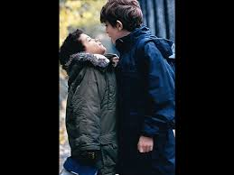

Slide 7
Co-occurring Disorders
ADHD
Anxiety Disorders
Mood Disorders (Depression, DMDD, Bipolar)
Learning Disorders
Language Disorders
Autism Spectrum Disorders

Slide 8
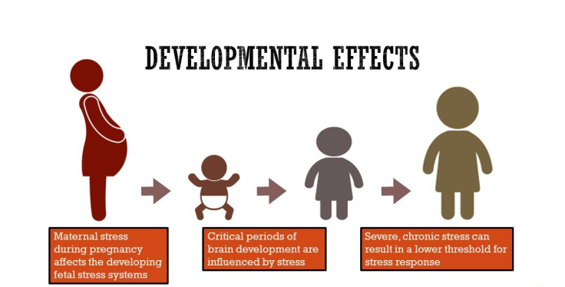
Environmental Risk Factors
High maternal stress in pregnancy
In-utero substance exposure
Short Derek. (n.d.). Adverse childhood experiences. Retrieved from http://slideplayer.com/slide/9351033/

Slide 9
Environmental Risk Factors
Insecure attachment
  Child abuse
  Neglect
  Harsh and/or rejecting parenting

Slide 10
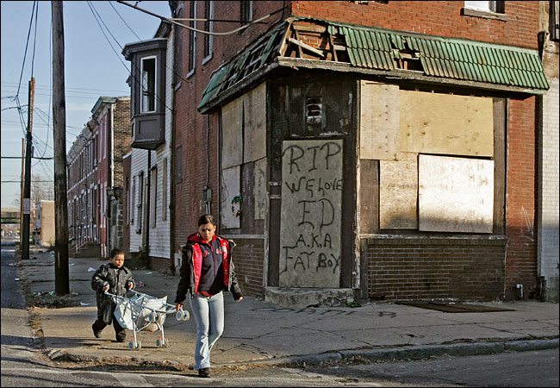
Environmental Risk Factors
Poverty
High stress
Low familial social support
Chaos in the home

Slide 11
Social Risk Factors
Social Learning Theory
  Home - DV, aggressive caregivers
  Community - violent neighborhoods
  School - unsafe environments
  Recreation - violent video games, tv

Slide 12
Social Risk Factors
Social exclusion/rejection
Bullying
Social humiliation
Access to weapons

Slide 13
Individual Risk Factors
Low IQ
Developmental delay
Difficult temperament
Brain injury
Previous aggression
Family history of antisocial behavior
Substance use
Psychological problems

Slide 14


Protective Factors
High IQ
Secure attachment
Adaptive coping skills
High frustration tolerance

Slide 15
Protective Factors
School investment
Popularity
Positive peer groups
Environment where aggression not rewarded
Supportive and positive academic environment
Church/religious involvement
Authoritative Parenting

Slide 16
Warning signs
Intense anger
Frequent loss of temper or blow-ups
Extreme irritability
Extreme impulsiveness

Slide 17


Slide 18
Prevention
Positive school climate
Student engagement
Increasing coping skills, resilience and emotional intelligence
Engage parents/guardians
Clear, authoritative disciplinary practices

Slide 19
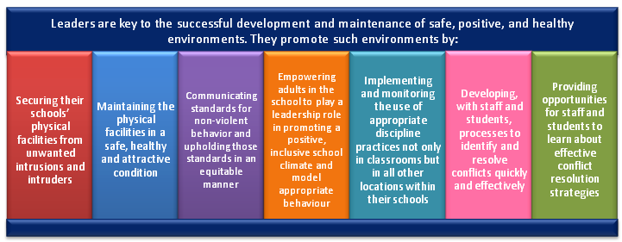

Slide 20
Early Detection
Screening (examples)
  NICHQ Vanderbilt Rating Scales
  SNAP
Evaluate for Co-Occurring Disorders, Stresses, and Trauma
  Children of color are more likely to be diagnosed with ODD and Conduct Disorder than white peers
  White peers are more likely to be diagnosed with ADHD and Learning Disorders are more likely to be assessed

Slide 21
NICHQ Vanderbilt Rating Scale
19. Argues with adults 0 1 2 3
20. Loses temper 0 1 2 3
21. Actively defies or refuses to go along with adults’ requests or rules 0 1 2 3
22. Deliberately annoys people 0 1 2 3
23. Blames others for his or her mistakes or misbehaviors
Is touchy or easily annoyed by others 0 1 2 3
25. Is angry or resentful 0 1 2 3
26. Is spiteful and wants to get even 0 1 2 3
27. Bullies, threatens, or intimidates others 0 1 2 3
28. Starts physical fights 0 1 2 3
29. Lies to get out of trouble or to avoid obligations (ie,“cons” others) 0 1 2 3
30. Is truant from school (skips school) without permission 0 1 2 3 31.
31. Is physically cruel to people 0 1 2 3 32. Has stolen things that have value

Slide 22
NICHQ Vanderbilt Rating Scale
31. Is physically cruel to people 0 1 2 3
32. Has stolen things that have value 0 1 2 3
33. Deliberately destroys others’ property
34. Has used a weapon that can cause serious harm (bat, knife, brick, gun) 0 1 2 3
35. Is physically cruel to animals 0 1 2 3
36. Has deliberately set fires to cause damage 0 1 2 3
37. Has broken into someone else’s home, business, or car
38. Has stayed out at night without permission 0 1 2 3
39. Has run away from home overnight 0 1 2 3
40. Has forced someone into sexual activity 0 1 2 3 4

Slide 23
Crisis Intervention
Calming period
Calling 211 (mobile crisis); 911 (ambulance); guardian to pick up
Discipline vs. specialized services
Behavior plans for unsafe behaviors
Assessing threat
Engaging the difficult to engage youth

Slide 24
Treatment
Parent Management Training
Collaborative Problem-Solving (Ross Greene)
Anger Control Therapy
Multisystemic Therapy
Treat Co-Occurring Disorders

Slide 25
Parent Management Training: Operant Conditioning
Positive Reinforcement: Presentation or of an event after a response that increases the likelihood or probability of that response
Negative Reinforcement: Removal of an event after a response that increases the likelihood or probability of that response
Punishment Presentation or removal of an event after a response that decreases the likelihood or probability of that response
Extinction No longer presenting a reinforcing event after a response that decreases the likelihood or probability of the previously reinforced response
Stimulus control: Reinforcing the response in the presence of one stimulus but not in and discrimination the presence of another. This procedure increases the likelihood or probability of the response in the presence of the former stimulus and decreases the likelihood or probability of the response in the presence of the latter stimulus

Slide 26
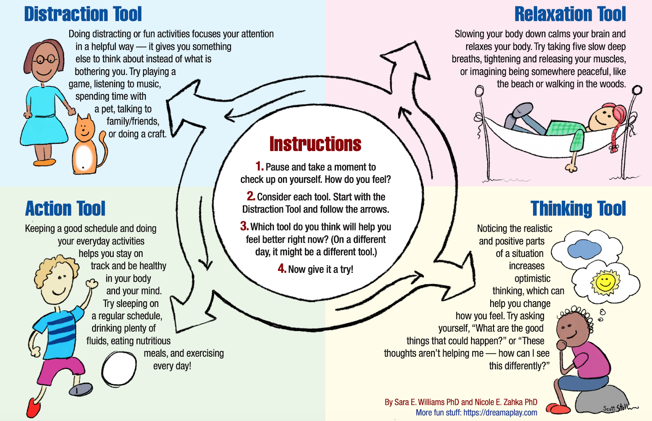

Slide 27
References
eAACAP Oppositional Defiant Disorder
https://www.aacap.org/App_Themes/AACAP/docs/resource_centers/odd/odd_resource_center_odd_guide.pdf
Parent Management Training
https://depts.washington.edu/hcsats/PDF/TF-%20CBT/pages/positive_parenting.html

Slide 28
References
Dubow, E. F., Huesmann, L. R., Boxer, P., & Smith, C. (2016). Childhood and Adolescent Risk and Protective Factors for Violence in Adulthood. Journal of Criminal Justice, 45, 26–31.
Herrera, Veronica & Mccloskey, Laura. (2003). Sexual Abuse, Family Violence, and Female Delinquency: Findings From a Longitudinal Study. Violence and Victims. 18. 319-34.
Litrownik, A. J., Newton, R., Hunter, W. M., English, D., & Everson, M. D. (2003). Exposure to family violence in young at-risk children: A longitudinal look at the effects of victimization and witnessed physical and psychological aggression. Journal of Family Violence, 18(1), 59-73.
Liu, Jianghong & Lewis, Gary & Evans, Lois. (2012). Understanding Aggressive Behavior Across the Life Span. Journal of Psychiatric and Mental Health Nursing. 20. 10.1111/j.1365-2850.2012.01902.x.
Moylan, C. A., Herrenkohl, T. I., Sousa, C., Tajima, E. A., Herrenkohl, R. C., & Russo, M. J. (2010). The Effects of Child Abuse and Exposure to Domestic Violence on Adolescent Internalizing and Externalizing Behavior Problems. Journal of Family Violence, 25(1), 53–63.

