Slide 1
Psychotic Disorders in Pregnancy and Postpartum Psychosis Katrina Furey, MD
February 20, 2025

Slide 2
Psychotic Disorders in Pregnancy
Mood Disorder with Psychotic Features
Call AMH for Moms: 833-978-6667

Slide 3
Psychotic Disorders in Pregnancy
Mood Disorder with Psychotic Features
Depression
Call AMH for Moms: 833-978-6667

Slide 4
Psychotic Disorders in Pregnancy
Mood Disorder with Psychotic Features
Depression
Mania
Call AMH for Moms: 833-978-6667

Slide 5
Psychotic Disorders in Pregnancy
Mood Disorder with Psychotic Features
Depression
Mania
Postpartum Psychosis
Call AMH for Moms: 833-978-6667

Slide 6
Psychotic Disorders in Pregnancy
Mood Disorder with Psychotic Features
Depression
Mania
Postpartum Psychosis
Schizophrenia-Spectrum Disorders
Call AMH for Moms: 833-978-6667

Slide 7
Psychotic Disorders
Mood Disorder with Psychotic Features
Depression
Mania
Postpartum Psychosis
Schizophrenia-Spectrum Disorders
Call AMH for Moms: 833-978-6667

Slide 8
What IS Psychosis?
“Psychosis refers to a collection of symptoms that affect the mind, where there has been some loss of contact with reality. During an episode of psychosis, a person’s thoughts & perceptions are disrupted, and they may have difficulty recognizing what is real and what is not.”
-National Institute of Mental Health
Call AMH for Moms: 833-978-6667

Slide 9
Postpartum Psychosis (PPP)
Call AMH for Moms: 833-978-6667

Slide 10
Postpartum Psychosis
Psychotic symptoms that emerge in postpartum period
Most severe & emergent perinatal mental health condition
5% suicide risk
4% infanticide risk
Call AMH for Moms: 833-978-6667

Slide 11
PPP Stats
Relatively rare – 0.0009-0.0026% (0.9-2.6/1,000 births) compared to:
80% baby blues
10-15% PPD
6-8% GAD
Up o 4% OCD
Call AMH for Moms: 833-978-6667

Slide 12
PPP Stats
Women are 23% more likely to experience psychosis in the month following childbirth than any other point in her life
Rates appear similar worldwide & among different cultures and socioeconomic statuses
However, majority of research has been performed in Europe & UK with homogenous populations
Call AMH for Moms: 833-978-6667

Slide 13
PPP & Bipolar
Women with bipolar disorder are at highest risk of postpartum psychosis (PPP)
New psychotic symptoms postpartum is bipolar disorder until proven otherwise
However, 20-50% of cases appear limited to postpartum¹
Bergink V, Rasgon N, Wisner KL. Postpartum Psychosis: Madness, Mania, and Melancholia in Motherhood. Am J Psychiatry. 2016 Dec 1;173(12):1179-1188 27609245
Call AMH for Moms: 833-978-6667

Slide 14
PPP Risk Factors
History of postpartum psychosis (80% relapse)
History of bipolar disorder
History of psychosis
Family history of bipolar disorder
Family history of psychotic illness, particularly PPP
Call AMH for Moms: 833-978-6667

Slide 15
PPP Risk Factors
Primiparity
If woman does not experience PPP after 1st delivery, very low odds of developing PPP after subsequent deliveries (Bergink et al. 2016)
Sleep deprivation
Medication discontinuation (especially if done quickly & for bipolar disorder)
Prior pregnancy loss
Call AMH for Moms: 833-978-6667

Slide 16
PPP Risk Factors
Many women have no prior risk factors
Blackmore et al. 2013 – large retrospective study that showed only 33% of women had antecedent history of mood symptoms
Blackmore ER, Rubinow DR, O'Connor TG, Liu X, Tang W, Craddock N, Jones I. Reproductive outcomes and risk of subsequent illness in women diagnosed with postpartum psychosis. Bipolar Disord. 2013 Jun;15(4):394-404 23651079
Call AMH for Moms: 833-978-6667

Slide 17
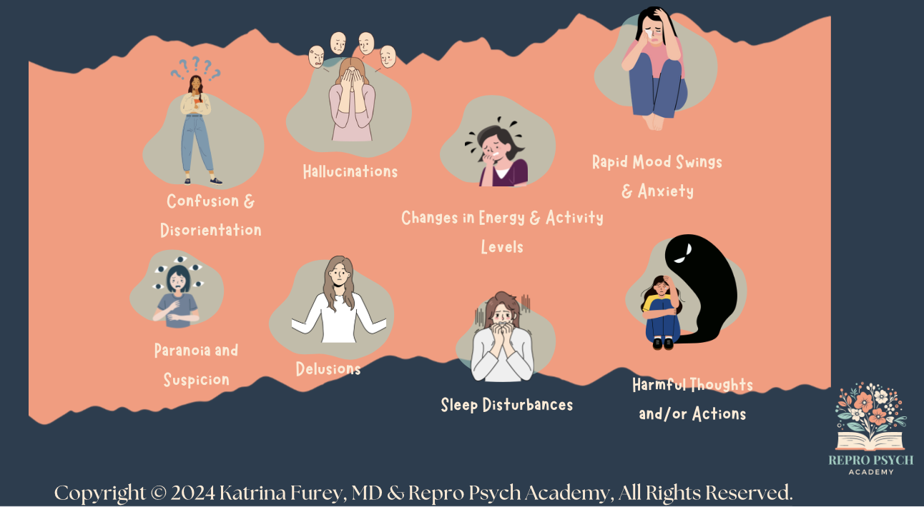
PPP Presentation
May include altruistic delusions about infanticide and/or homicide and/or suicide that MUST be addressed IMMEDIATELY
Call AMH for Moms: 833-978-6667

Slide 18
PPP Presentation
PPP typically appears 24hrs to 3wks after delivery
Most common within first 2wks
Women with known BD may experience onset earlier in postpartum period (Bergink et al. 2016)
High suspicion if mom sleep deprived for >48hrs & does not feel tired
Call AMH for Moms: 833-978-6667

Slide 19
PPP Presentation
Early prodromal symptoms may be mild & difficult to distinguish from typical postpartum mood, activity & sleep changes
Insomnia, mood fluctuations, anxiety, irritability
Must distinguish between decreased need for sleep vs decreased sleep time
High suspicion for PPP if new mom goes 48hrs without sleep and does not feel tired
Call AMH for Moms: 833-978-6667

Slide 20
PPP Presentation
As illness progresses, frank mood disturbances & delirium-like changes in mental status become apparent
Waxing & waning mental status changes like disorientation, confusion, and disorganization
Mood and psychotic symptoms may also wax & wane
Call AMH for Moms: 833-978-6667

Slide 21
PPP Presentation
Psychotic symptoms often include delusions involving the infant and pose biggest risk to mom & baby
Psychotic delusions are not always ego-syntonic
Many survivors describe an early period of insight where they realize they are experiencing psychotic symptoms and feel scared to act on them
Progression to more psychotic frame of mind with ego-syntonic delusions can occur rapidly (within 24hrs)
Call AMH for Moms: 833-978-6667

Slide 22
PPP & Safety Risks
5% rate of suicide & 1% rate of infanticide
Most maternal filicides are either:
Part of altruistic delusions associated with belief that death is in child’s best interest
Occur in acute psychosis with no comprehensible motive
20% of maternal filicides end in completed suicide by the mother²
2. Hatters Friedman S, Resnick PJ. Child murder by mothers: patterns and prevention. World Psychiatry. 2007 Oct;6(3):137-41 18188430
Call AMH for Moms: 833-978-6667

Slide 23
PPP Prognosis
Majority of cases represent underlying bipolar disorder
50-80% of women with first episode PPP go on to develop a serious psychiatric disorder, most often BD¹
20-50% of cases appear limited to postpartum¹
Symptoms last, on average³:
1 month (manic features)
2.5 months (mixed or depressed features)
3. Bergink V, Lambregtse-van den Berg MP, Koorengevel KM, Kupka R, Kushner SA. First-onset psychosis occurring in the postpartum period: a prospective cohort study. J Clin Psychiatry. 2011 Nov;72(11):1531-7 21903022
Call AMH for Moms: 833-978-6667

Slide 24
PPP Prognosis
Most women return to premorbid functioning within 9 months⁴
Symptoms can persist up to 1yr postpartum in 25% of women
Risk factors for prolonged course^{4,5}:
Relapse
Episode of depression following resolution of acute psychosis
4. Burgerhout KM, Kamperman AM, Roza SJ, Lambregtse-Van den Berg MP, Koorengevel KM, Hoogendijk WJ, Kushner SA, Bergink V. Functional Recovery After Postpartum Psychosis: A Prospective Longitudinal Study. J Clin Psychiatry. 2017 Jan;78(1):122-128 27631144
5. Blackmore ER, Rubinow DR, O'Connor TG, Liu X, Tang W, Craddock N, Jones I. Reproductive outcomes and risk of subsequent illness in women diagnosed with postpartum psychosis. Bipolar Disord. 2013 Jun;15(4):394-404 23651079
Call AMH for Moms: 833-978-6667

Slide 25
PPP Prognosis
1/3 of women will have recurrent episode with future pregnancy
Recurrence rate higher for women with psychosis only in postpartum period compared to women with BD⁶
Risk factors for recurrence⁵:
Longer duration
Increased severity of initial PPP episode
More time between pregnancies
6. Wesseloo R, Kamperman AM, Munk-Olsen T, Pop VJ, Kushner SA, Bergink V. Risk of Postpartum Relapse in Bipolar Disorder and Postpartum Psychosis: A Systematic Review and Meta-Analysis. Am J Psychiatry. 2016 Feb 1;173(2):117-27 26514657
Call AMH for Moms: 833-978-6667

Slide 26
PPP Treatment
Requires immediate and emergent evaluation
Hospitalization usually necessary
Medication (antipsychotics +/- mood stabilizer) usually indicated
ECT
Preventative treatment (medications, ECT) needed for subsequent pregnancies
Call AMH for Moms: 833-978-6667

Slide 27
PPP Treatment
Requires immediate and emergent evaluation
Hospitalization usually necessary
Medication (antipsychotics +/- mood stabilizer) usually indicated
ECT
Preventative treatment (medications, ECT) needed for subsequent pregnancies
Call AMH for Moms: 833-978-6667

Slide 28
Schizophrenia
Spectrum Disorders
Call AMH for Moms: 833-978-6667

Slide 29
Schizophrenia Spectrum Disorders
Brief Psychotic Disorder: 1 day to 1 month.
Schizophreniform Disorder: >1 month to 6 months.
Schizophrenia: 6+ months with at least 1 month of active phase symptoms.
Call AMH for Moms: 833-978-6667

Slide 30
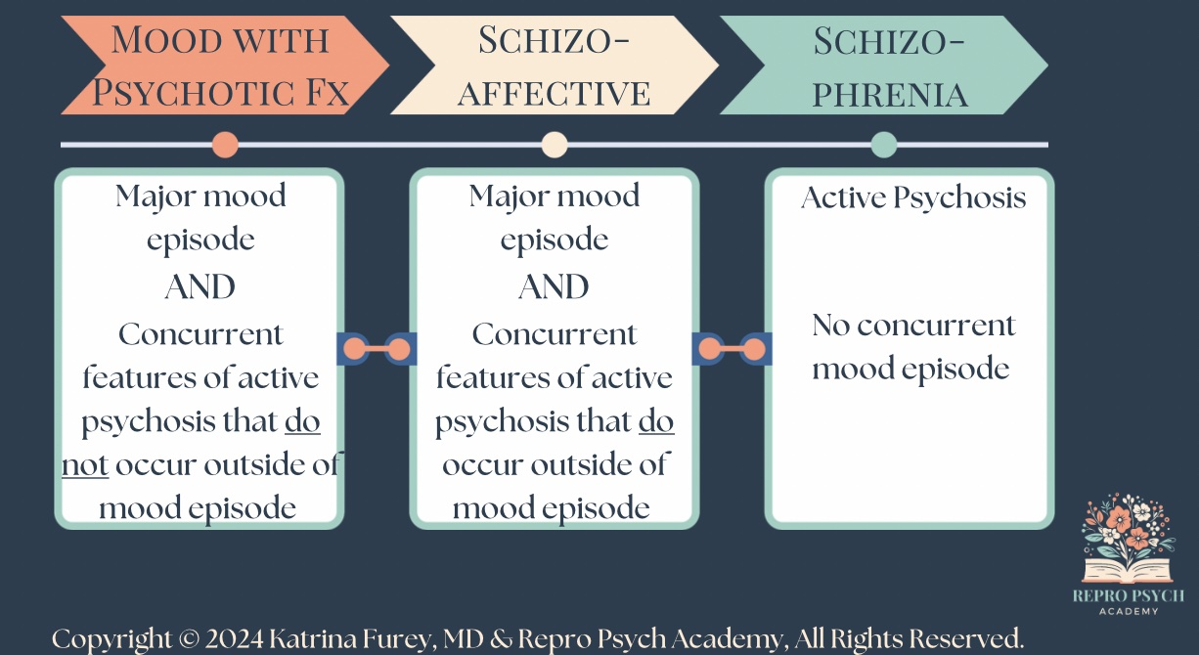
Schizophrenia Differential Diagnosis
Call AMH for Moms: 833-978-6667

Slide 31
Schizophrenia
Disorder characterized by abnormalities of perception, thought, behavior, affect & cognition
Lifetime prevalence 7.2/1,000 people
M>W 1.4:1 before 40yo
W>M 2:1 after 40yo
Women experience 2nd peak in middle age & predominance switches
Call AMH for Moms: 833-978-6667

Slide 32
Schizophrenia
Onset typically early 20s
Onset may be gradual (more common) or acute with clear precipitant (i.e. synthetic cannabis use)
Prodromal periods characterized by prominent cognitive & negative symptoms
Call AMH for Moms: 833-978-6667

Slide 33
Schizophrenia
Chronic course with exacerbations & remissions
Decline in baseline functioning after each exacerbation
Majority of patients are functionally impaired and/or unemployed
1/3 able to maintain relatively normal levels of functioning⁷
7. Sadock BJ, Sadock VA, Ruiz P (eds): Schizophrenia spectrum and other psychotic disorders, in Kaplan and Sadock’s Synopsis of Pregnancy: Behavioral Sciences/Clinical Psychiatry, 11th Edition, Philadelphia, PA, Lippincott, Williams and Wilkins, 2015, pp 317-318.
Call AMH for Moms: 833-978-6667

Slide 34
Schizophrenia
13x more likely to die by suicide than the general population⁸
Life expectancy 10-25 years shorter, even after accounting for suicide⁹
8. Saha S, Chat D, McGrath J: A systematic review of mortality in schizophrenia: is the differential mortality gap worsening over time? Arch Gen Psychiatry 64(10):1123-1131, 2007 17909124
9. Lambert TJ: The medical care of people with psychosis. Med J Aust 190(4):171– 172, 2009 19220177
Call AMH for Moms: 833-978-6667

Slide 35
Schizophrenia Risk Factors
Adapted from “Textbook of Women’s Reproductive Mental Health” Chapter 17, p446, Table 17-1.
Genetics – 40-50% concordance for monozygotic twins vs 6-10% for dizygotic¹⁰
Perinatal complications¹¹:
In utero infection, particularly influenza or rubella in 1st trimester
Stress (?confounding variables)
Obstetrical complications like preeclampsia, GDM, emergency c-section, low birth weight
10. Cardno AG, Gottesman II: Twin studies of schizophrenia: from bow-and-arrow concordances to star wars Mx and functional genomics. Am J Med Genet 97(1):12– 17, 2000 10813800
11. Clarke MC, Kelleher I, Clancy M, et al: Predicting risk and the emergence of schizophrenia. Psychiatr Clin North Am 35(3):585– 612, 2012 22929868
Call AMH for Moms: 833-978-6667

Slide 36
Schizophrenia Risk Factors
Adapted from “Textbook of Women’s Reproductive Mental Health” Chapter 17, p446, Table 17-1.
Cannabis Use
In utero exposure
Personal use
↑ risk in people with specific alleles of catechol-O-methyltransferase (COMT) gene¹¹
Aquired brain injury
Anti-NMDA receptor encephalitis
Epilepsy
Call AMH for Moms: 833-978-6667

Slide 37
Schizophrenia Risk Factors
Adapted from “Textbook of Women’s Reproductive Mental Health” Chapter 17, p446, Table 17-1.
“Schizophrenia risk is related to a complex synergistic interaction between genetic susceptibility and environmental exposures beginning in the prenatal environment and continuing through adulthood”
-“Textbook of Women’s Reproductive Mental Health” Chapter 17, p447.
Call AMH for Moms: 833-978-6667

Slide 38
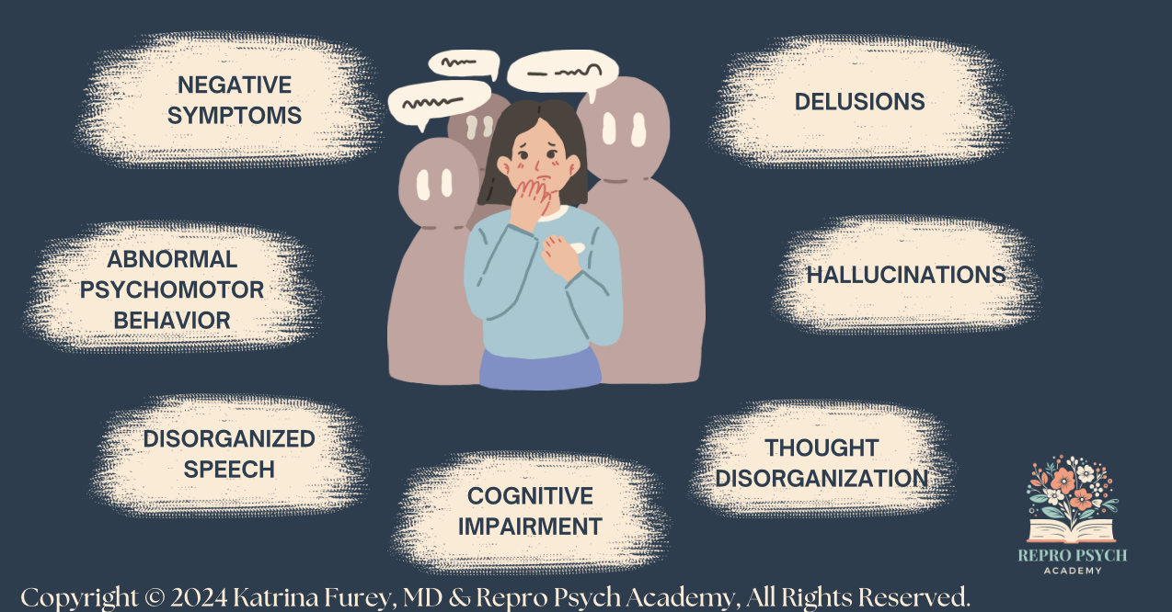
Schizophrenia Symptoms
Call AMH for Moms: 833-978-6667

Slide 39
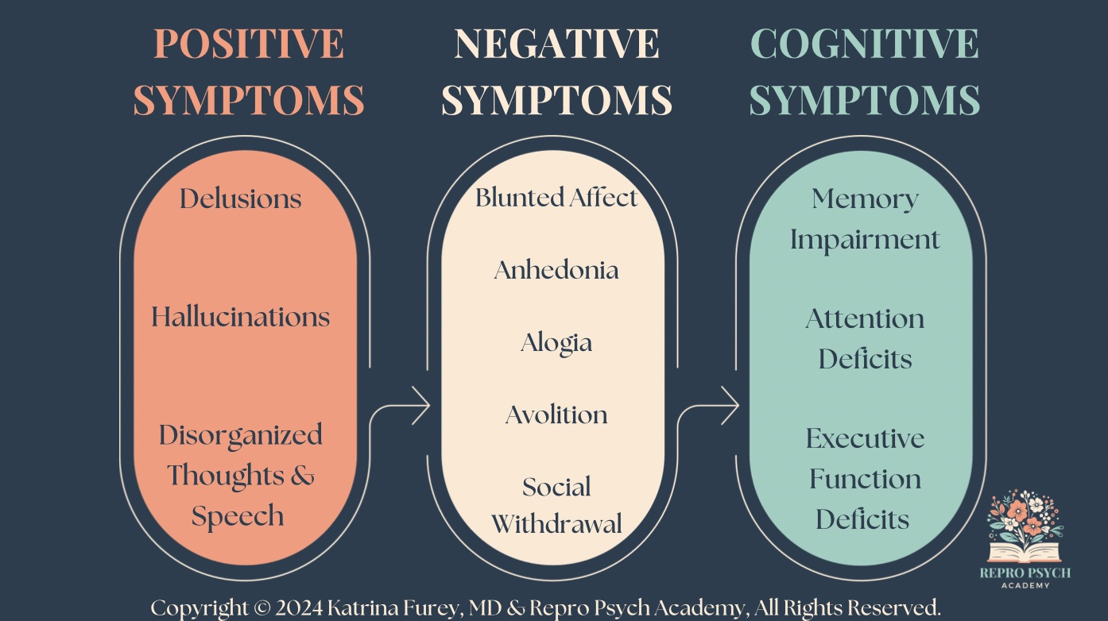
Schizophrenia Symptoms
Call AMH for Moms: 833-978-6667

Slide 40
Positive Symptoms
Delusions: fixed, false beliefs that persist despite clear evidence to the contrary; may be bizarre or non-bizarre and may encompass many different themes; often involve fetus/infant during perinatal period.
Hallucinations: perception-like experiences, in any sensory modality, that occur in the absence of true external stimuli.
Call AMH for Moms: 833-978-6667

Slide 41
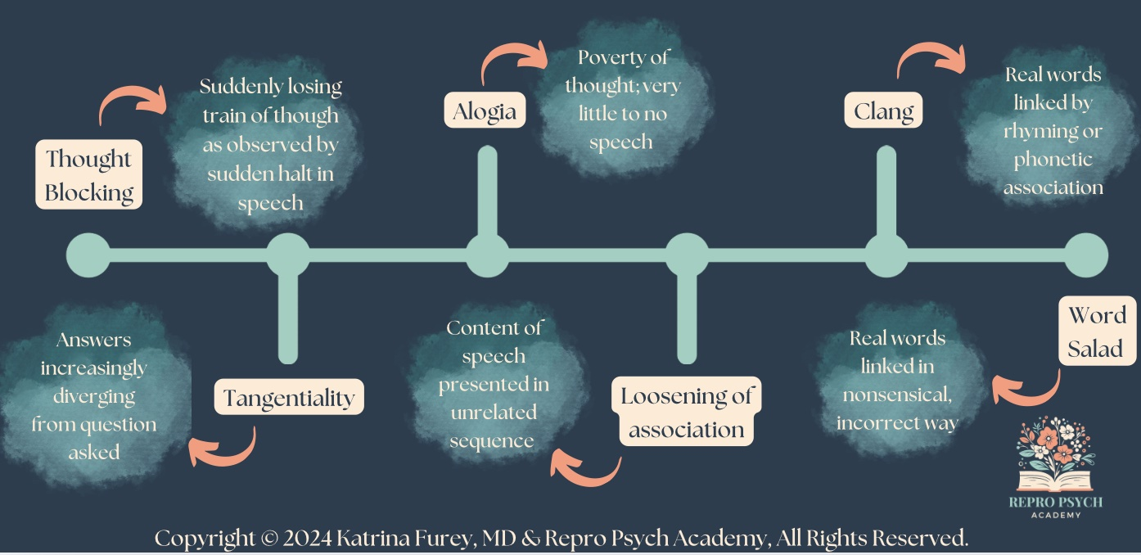
Positive Symptoms
Thought & Speech Disorganization: (i.e. frequent
derailment or incoherence) – ranges from tangentiality to complete incoherence
Call AMH for Moms: 833-978-6667

Slide 42
Positive Symptoms
Disorganized Behaviors
Agitation
Aggression – often in self defense
Responding to internal stimuli (RIS)
Patient preoccupied with & engaged in interaction with hallucination
Looking around room
Whispering under their breath
Carrying on full conversation
Laughing, smiling or yelling inappropriately
Call AMH for Moms: 833-978-6667

Slide 43
Positive Symptoms
Catatonia: abnormal movement despite having physical ability to move normally
Call AMH for Moms: 833-978-6667

Slide 44
Negative Symptoms
Negative symptoms are more stable throughout course & have higher negative predictive value than positive symptoms
Three Clusters of Symptoms:
Diminished Expression
Avolition/Amotivation
a lack of interest or engagement in goal-directed behavior
Apathy
lack of interest, enthusiasm, or concern
Call AMH for Moms: 833-978-6667

Slide 45
Cognitive Symptoms
Often present in prodromal period before schizophrenia diagnosis
May display impairments in:
Memory
Attention
Processing Speed
Executive Function
Orientation
May display waxing & waning mental status
Call AMH for Moms: 833-978-6667

Slide 46
Reproductive Considerations
Women tend to have a better prognosis until 3rd decade of illness, when this reverses^{12,13,14}
Later onset
Less severe symptoms
Better premorbid social and occupational functioning
Fewer negative symptoms
12. Sadock BJ, Sadock VA, Ruiz P (eds): Schizophrenia spectrum and other psychotic disorders, in Kaplan and Sadock’s Synopsis of Pregnancy: Behavioral Sciences/Clinical Psychiatry, 11th Edition, Philadelphia, PA, Lippincott, Williams and Wilkins, 2015, pp 317-318.
13. Riecher-Rössler A, Pflüger M, Borgwardt S: Schizophrenia in women, in Oxford Textbook of Women and Mental Health. Edited by Kohen D. New York, Oxford University Press, 2010, pp 102– 114
14. Yaeger D, Smith HG, Altshuler LL: Atypical antipsychotics in the treatment of schizophrenia during pregnancy and the postpartum. Am J Psychiatry 163(12):2064– 2070, 2006 17151155
Call AMH for Moms: 833-978-6667

Slide 47
Reproductive Considerations
Women tend to have a better prognosis until 3rd decade of illness, when this reverses^{12,13,14}
Shorter hospital stays
Fewer legal problems
More intimate partnerships
Lower suicide risk
12. Sadock BJ, Sadock VA, Ruiz P (eds): Schizophrenia spectrum and other psychotic disorders, in Kaplan and Sadock’s Synopsis of Pregnancy: Behavioral Sciences/Clinical Psychiatry, 11th Edition, Philadelphia, PA, Lippincott, Williams and Wilkins, 2015, pp 317-318.
13. Riecher-Rössler A, Pflüger M, Borgwardt S: Schizophrenia in women, in Oxford Textbook of Women and Mental Health. Edited by Kohen D. New York, Oxford University Press, 2010, pp 102– 114
14. Yaeger D, Smith HG, Altshuler LL: Atypical antipsychotics in the treatment of schizophrenia during pregnancy and the postpartum. Am J Psychiatry 163(12):2064– 2070, 2006 17151155
Call AMH for Moms: 833-978-6667

Slide 48
Reproductive Considerations
Historically, women with schizophrenia had lower fertility rates due to institutionalization and hyperprolactinemia side effect of typical (1st generation) antipsychotics
Presently, rates of pregnancy about equal with general population
>50% women with schizophrenia will have at least one pregnancy¹⁵
15. Howard L, Kumar R, Thornicroft G: Psychosocial characteristics and needs of mothers with psychotic disorders. Br J Psychiatry 178(5):427– 432, 2001 11331558
Call AMH for Moms: 833-978-6667

Slide 49
Perinatal Considerations
Limited data investigating impact of pregnancy on course of schizophrenia & available data complicated by many confounding variables
Pregnancy does not seem “protective”
Many experts recommend considering all pregnancies in women with schizophrenia as “high risk”
Call AMH for Moms: 833-978-6667

Slide 50
Perinatal Considerations
Taylor et al. 2018¹⁶
Severity of illness prior to pregnancy & decisions about maintenance medications predict likelihood of relapse
Rates of psychiatric hospitalization or self-harming in cohort of British women with SMI
24% of women with nonaffective psychotic illness
12% with MDD or BD w/psychotic features
16. Taylor CL, Broadbent M, Khondoker M, et al: Predictors of severe relapse in pregnant women with psychotic or bipolar disorders. J Psychiatr Res 104:100– 107, 2018 30015264
Call AMH for Moms: 833-978-6667

Slide 51
Perinatal Considerations
Risks for relapse¹⁶:
Recent hospital admission
Recent self-harm
Substance misuse
Smoking
Lack of maintenance medication during 1st trimester
Call AMH for Moms: 833-978-6667

Slide 52
Perinatal Considerations
Petersen et al. 2014¹⁷
Database of 500,000 women
By beginning of 3rd trimester, only 38% of women prescribed atypical (2nd generation) and 19% of women prescribed typical (1st generation) antipsychotics were still taking the medication
17. Petersen I, McCrea RL, Osborn DJ, et al: Discontinuation of antipsychotic medication in pregnancy: a cohort study. Schizophr Res 159(1):218– 225, 2014 25171856
Call AMH for Moms: 833-978-6667

Slide 53
Postpartum Considerations
↑ risk of relapse during postpartum period^{18,19} (Munk-Olsen et al. 2009 & 2006)
5-fold ↑ risk of first-time hospitalization in first 30 days postpartum
5-fold ↑ risk of hospital readmission within the first 20 days postpartum
18. Munk-Olsen T, Laursen TM, Pedersen CB, et al: New parents and mental disorders: a population-based register study. JAMA 296(21):2582– 2589, 2006 17148723
19. Munk-Olsen T, Laursen TM, Mendelson T, et al: Risks and predictors of readmission for a mental disorder during the postpartum period. Arch Gen Psychiatry 66(2):189– 195, 2009 19188541
Call AMH for Moms: 833-978-6667

Slide 54
Postpartum Considerations
↑ risk of relapse during postpartum period^{18,19} (Munk-Olsen et al. 2009 & 2006)
↑ risk of hospitalization through 6 months postpartum (though lower compared to first month)
Rates of hospitalization were lower compared to women with BD
18. Munk-Olsen T, Laursen TM, Pedersen CB, et al: New parents and mental disorders: a population-based register study. JAMA 296(21):2582– 2589, 2006 17148723
19. Munk-Olsen T, Laursen TM, Mendelson T, et al: Risks and predictors of readmission for a mental disorder during the postpartum period. Arch Gen Psychiatry 66(2):189– 195, 2009 19188541
Call AMH for Moms: 833-978-6667

Slide 55
Postpartum Considerations
Risks for postpartum relapse:²⁰
Acute symptoms during pregnancy
Medical or psychiatric comorbidity
Older age
Psychosocial stressors like lower socioeconomic status & limited social support
Less engagement in prenatal care
20. Rochon-Terry G, Gruneir A, Seeman MV, et al: Hospitalizations and emergency department visits for psychiatric illness during and after pregnancy among women with schizophrenia. J Clin Psychiatry 77(4):541– 547, 2016 27035409
Call AMH for Moms: 833-978-6667

Slide 56
Perinatal Risks of Schizophrenia^{21,22,23}
Note that the data is limited by study designs not controlling for confounding variable and medication use
Poor prenatal care
Substance misuse
Poor nutrition
Exposure to IPV
Medical comorbidities like diabetes, obesity, hypertension
21. Abel KM, Au K, Howard LM: Schizophrenia, psychopharmacology, and pregnancy, in Psychopharmacology and Pregnancy: Treatment Efficacy, Risks, and Guidelines. Edited by Galbally M, Snellen M, Lewis A. Berlin, Springer, 2014, pp 119– 138
22. Friedman SH, Moller-Olsen C, Prakash C, et al: Atypical antipsychotic use and outcomes in an urban maternal mental health service. Int J Psychiatry Med 51(6):521– 533, 2016 28629296
23. Tosato S, Albert U, Tomassi S, et al: A systematized review of atypical antipsychotics in pregnant women: balancing between risks of untreated illness and risks of drug-related adverse effects. J Clin Psychiatry 78(5):e477– e489, 2017 28297592
Call AMH for Moms: 833-978-6667

Slide 57
Perinatal Risks of Schizophrenia^{21,22,23}
Note that the data is limited by study designs not controlling for confounding variable and medication use
Child neglect or abuse
Preterm delivery
Low APGAR scores
IUGR
Low birth weight
21. Abel KM, Au K, Howard LM: Schizophrenia, psychopharmacology, and pregnancy, in Psychopharmacology and Pregnancy: Treatment Efficacy, Risks, and Guidelines. Edited by Galbally M, Snellen M, Lewis A. Berlin, Springer, 2014, pp 119– 138
22. Friedman SH, Moller-Olsen C, Prakash C, et al: Atypical antipsychotic use and outcomes in an urban maternal mental health service. Int J Psychiatry Med 51(6):521– 533, 2016 28629296
23. Tosato S, Albert U, Tomassi S, et al: A systematized review of atypical antipsychotics in pregnant women: balancing between risks of untreated illness and risks of drug-related adverse effects. J Clin Psychiatry 78(5):e477– e489, 2017 28297592
Call AMH for Moms: 833-978-6667

Slide 58
Perinatal Risks of Schizophrenia^{21,22,23}
Note that the data is limited by study designs not controlling for confounding variable and medication use
Congenital malformation
Placental abruption
Stillbirth
Infant death
21. Abel KM, Au K, Howard LM: Schizophrenia, psychopharmacology, and pregnancy, in Psychopharmacology and Pregnancy: Treatment Efficacy, Risks, and Guidelines. Edited by Galbally M, Snellen M, Lewis A. Berlin, Springer, 2014, pp 119– 138
22. Friedman SH, Moller-Olsen C, Prakash C, et al: Atypical antipsychotic use and outcomes in an urban maternal mental health service. Int J Psychiatry Med 51(6):521– 533, 2016 28629296
23. Tosato S, Albert U, Tomassi S, et al: A systematized review of atypical antipsychotics in pregnant women: balancing between risks of untreated illness and risks of drug-related adverse effects. J Clin Psychiatry 78(5):e477– e489, 2017 28297592
Call AMH for Moms: 833-978-6667

Slide 59
Perinatal Schizophrenia Treatment
Always requires medication
Acute psychosis may require inpatient hospitalization with careful discharge & relapse prevention planning
May require intervention like ECT
Address psychosocial supports & stressors
Call AMH for Moms: 833-978-6667

Slide 60
Perinatal Schizophrenia Treatment
Ensure Safety
Promote Sleep
Improve Psychosis & Stabilize Mood
Emergency Plan
Call AMH for Moms: 833-978-6667

Slide 61
Perinatal Schizophrenia Treatment
Ensure Safety
Psychiatric birth plan
Psychoeducation for patient, family, providers
Promote Sleep
Improve Psychosis & Stabilize Mood
Emergency Plan
Call AMH for Moms: 833-978-6667

Slide 62
Perinatal Schizophrenia Treatment
Ensure Safety
Promote Sleep
Total of eight hours overnight with at least one longer period of uninterrupted sleep (ideally 4-6 hours), especially in the first three weeks postpartum
Improve Psychosis & Stabilize Mood
Emergency Plan
Call AMH for Moms: 833-978-6667

Slide 63
Perinatal Schizophrenia Treatment
Ensure Safety
Promote Sleep
Improve Psychosis & Stabilize Mood
Reproductive safety data for antipsychotics are generally reassuring
Aim to minimize polypharmacy
Emergency Plan
Call AMH for Moms: 833-978-6667

Slide 64
Perinatal Schizophrenia Treatment
Ensure Safety
Promote Sleep
Improve Psychosis & Stabilize Mood
Use agents with more reproductive safety information
Haloperidol, risperidone, olanzapine, aripirazole & quetiapine preferred over lurasidone, asenapine, cariprazine & other newer agents
Emergency Plan
Call AMH for Moms: 833-978-6667

Slide 65
Perinatal Schizophrenia Treatment
Ensure Safety
Promote Sleep
Improve Psychosis & Stabilize Mood
Emergency Plan
911, 988 or directly to ER
Call AMH for Moms: 833-978-6667

Slide 66
Perinatal Schizophrenia Treatment
Ensure Safety
Promote Sleep
Improve Psychosis & Stabilize Mood
Emergency Plan
Postpartum Support International (PSI) HelpLine
8am-11pm EST every day of the week
Call 1-800-944-4773 (#1 English, #2 Spanish)
Text in English 800-944-4773 or in Spanish 971-203-7773
Call AMH for Moms: 833-978-6667

Slide 67
Perinatal Schizophrenia Treatment
Ensure Safety
Promote Sleep
Improve Psychosis & Stabilize Mood
Emergency Plan
National Maternal Mental Health Hotline
Free, confidential, 24/7
1-833-TLC-MAMA
Call AMH for Moms: 833-978-6667

Slide 68
Referral Resources
Internal referral to therapy and/or medication provider.
Patient can call insurance company or use PsychologyToday.com
Call AMH for Moms at 1-833-978-MOMS (6667) Monday-Friday 9:00am-5:00pm for clinical consultation & assistance connecting patients to treatment.
Postpartum Support International (PSI) Provider Directory (https://psidirectory.com) or telephone consultation with a perinatal psychiatry expert at 1-877-499-4773.
National Maternal Mental Health Hotline 1-833-TLC-MAMA (852-6262)
211, 911 or 988 for emergencies
Call AMH for Moms: 833-978-6667

Slide 69
Thank You!!!
Call AMH for Moms: 833-978-6667

