Slide 1

Introduction to Bipolar Disorder Disorder in the Perinatal Period
Jennifer McMahon, MD
Contributions by Katrina Furey MD
February 8th, 2024

Slide 2
No conflicts to report

Slide 3
Bipolar Disorder
Epidemiology
Diagnosis
Screening
Management

Slide 4
Epidemiology
Lifetime prevalence of bipolar spectrum disorder of 2.4%
Disorder characterized by discrete episodes of depression, hypomania, and mania
Data from the World Mental Health Survey Initiative
Merikangas et al., 2011

Slide 5
Bipolar Disorder Subtypes
Bipolar I – one lifetime manic episode; usually also experience hypomania & major depressive episodes
Bipolar II – at least 1 hypomanic episode + at least 1 depressive episode; 0 manic episodes
Some patients have mixed episodes with features of depression and hypomania/mania
Call AMH for Moms: 833-978-6667

Slide 6
Mania and Hypomania
Inflated self-esteem or grandiosity
Decreased need for sleep
More talkative than usual
Flight of ideas or racing thoughts
Distractibility
Increase in goal-directed activity
Excessive involvement in activities with high risk for painful consequences (ex: buying sprees, sexual indiscretions)
A period of elevated, expansive, or irritable mood and increased energy and activity with 3 or more symptoms:

Slide 7
Hypomania vs Mania
Hypomania lasts 4+ days
  less severe & does not cause marked impairment in social, occupational or personal functioning
  does not necessitate hospitalization
  No psychotic features
Mania lasts 7+ days
  causes severe functional impairment
  necessitates hospitalization
  or there are psychotic features
Call AMH for Moms: 833-978-6667

Slide 8
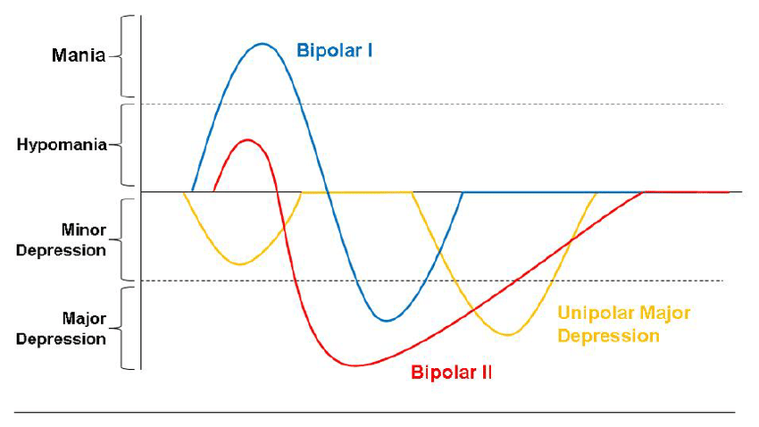
Bipolar I, Bipolar II, MDD
Call AMH for Moms: 833-978-6667

Slide 9
Bipolar disorder is the greatest risk factor for….

Slide 10
Postpartum psychosis
Some women are ultimately found to have bipolar disorder after experiencing an initial episode of psychosis in the postpartum period
(Bergink et al., 2016; Wesseloo et al., 2016).

Slide 11
Postpartum psychosis
General onset 3 -10 days postpartum
Prodromal symptoms: insomnia, mood fluctuation, anxiety, irritability
Mood disturbances: manic, mixed, depressed mood episodes
Psychotic symptoms: delusions (often but not always about infant), auditory hallucinations, disorganization
Delirium-like waxing and waning of cognition and confusion
Psychiatric emergency:
  5% risk of suicide
  4% risk of infanticide

Slide 12
Postpartum Psychosis: Clinical Presentation
General onset 3 -10 days postpartum
Prodromal symptoms: insomnia, mood fluctuation, anxiety, irritability
Mood disturbances: manic, mixed, depressed mood episodes
Psychotic symptoms: delusions (often but not always about infant), auditory hallucinations, disorganization
Delirium-like waxing and waning of cognition and confusion
Psychiatric emergency:
  5% risk of suicide
  4% risk of infanticide
Notes:
textbook

Slide 13
Bipolar Disorder
Onset of symptoms is often during reproductive years
Women in the perinatal period who report depressive symptoms should be carefully assessed for bipolar disorder.
In a study that screened women for postpartum depression, about 1 in 5 women were found to have bipolar disorder
(Tondo et al., 2010
(Wisner et al., 2013).

Slide 14
Clues to Diagnosis
Family history of bipolar disorder
Onset of symptoms during or before adolescence
Lack of response to antidepressants or hypomania/activation with treatment with an antidepressant
Prior diagnoses of ADHD, disruptive behavior disorders, anxiety disorders
History of substance use
Frequent episodes
Call AMH for Moms: 833-978-6667

Slide 15
Bipolar Disorder – Assessment
Consists of clinical interview, family history & rating scales like MDQ
Check for underlying medical conditions – TSH, B12, vitamin D, Hb/Hct
Differential diagnosis – trauma, personality disorders, substance use, psychotic disorder
Call AMH for Moms: 833-978-6667

Slide 16
(+) Mania
  ”yes” to 7+ events in question 1
  “yes” to question 2
  ”moderate to serious” in question 3
Call AMH for Moms: 833-978-6667

Slide 17
Bipolar Disorder - Treatment
Requires medication management
Typically mood stabilizer +/- atypical antipsychotic
SSRIs can worsen symptoms
Call AMH for Moms: 833-978-6667

Slide 18

Risk-risk conversation
There is no risk free decision!
Need to mitigate BOTH:
  Risks of untreated/undertreated mental illness
  Risks of treatment

Slide 19
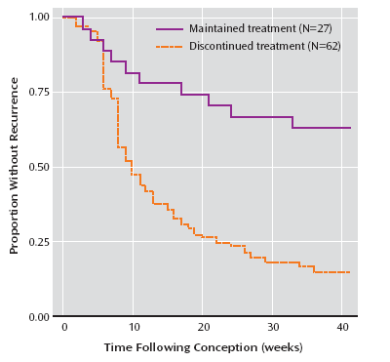
Risk of recurrence
Pregnancy is NOT protective against a mood episode
The risk is greater for those who abruptly discontinued medication compared to gradually tapering the medication
Viguera et al, Am J of Psychiatry, 164, 12, 200

Slide 20

Risks of untreated bipolar disorder
Risks to Mother
Increased risk of mood episode
Increased risk of postpartum psychosis
Pregnancy complications/Risk to baby:
Placental abnormalities
Preeclampsia
High risk behaviors (hypersexuality, substance use)
Decreased prenatal care
Low birth weight
Neonatal hypoglycemia
preterm birth
Antepartum hemorrhage

Slide 21
What medication do I choose?
What medication has worked in the past? What has not worked?
What are the side effects? Has patient tolerated it before?
How much data do we have for the medication?
What does the data tell us?
What is the patient’s preference?

Slide 22
Other considerations
Use lowest EFFECTIVE dose
Maximize non-pharmacologic interventions
Avoid polypharmacy
Educate everyone – patient, family, other providers
Try to make changes before pregnancy!
Try to avoid abrupt discontinuation

Slide 23
Treatment – Mood stabilizers

Slide 24
Lamotrigine
Older data reported increased rate of oral clefts defects, however several other studies and international registries have not found an increased risk of major malformations.
Lamotrigine clearance increases throughout pregnancy and therefore typically requires a dose increase.
  After delivery, clearance rates decline quickly and lamotrigine dosing should be adjusted accordingly
(Khan et al., 2016;; Yonkers et al., 2004; Deligiannidis et al., 2014;

Slide 25
Lithium
Risk for cardiac malformations likely much smaller than initially thought
  Risk likely dose-dependent, with those taking >900 mg at highest risk
Risk of infant diabetes insipidus leading to polyhydramnios
Rare association with newborn decreased muscle tone and initial difficultly breathing and feeding
Other neonatal complications have been reported: neonatal hyperbilirubinemia, cardiac arrhythmias, hypothyroidism
Khan et al., 2016; Deligiannidis et al., 2014; Patorno et al., 2017

Slide 26
Monitoring
Close monitoring of Li levels throughout pregnancy as clearance of Lithium increases.
Check a level anytime the pt is at risk for dehydration (ex: hyperemesis gravidarum, prolonged labor) or has impaired renal function (ex preeclampsia).
Regularly monitor of kidney and thyroid function
After birth, Li should be reduced due to a quick return to baseline clearance rates following delivery

Slide 27
AVOID Valproic acid and Carbamazepine
Valproic acid
Given its teratogenicity and neurodevelopmental risks, valproic acid is avoided during pregnancy.
The risk increases dose-dependently, although the risk of malformations remains with all doses of valproic acid
Carbamazepine
Also considered a teratogen with risk of congenital malformations appearing to be dose dependent
Neural tube defects, craniofacial abnormalities, and cardiac and urinary tract defects
Neural tube defects, heart defects, and oral clefts

Slide 28
Treatment – Antipsychotics

Slide 29
Antipsychotics
Typical (first generation)
More likely to cause extrapyramidal symptoms
Ex: haloperidol, fluphenazine, perphenazine, chlorpromazine
Atypical (second generation)
More likely to cause metabolic side effects
Ex: olanzapine, quetiapine, aripiprazole, risperidone
Lieberman and First, 2018

Slide 30
Antipsychotics
Typical antipsychotics: Some reports of EPS in baby
Atypical antipsychotics: Metabolic effects in infant possible
  Newer atypical antipsychotics unknown (ex: lurasidone)
Typical and atypical antipsychotics are unlikely to be major teratogens
  Risperidone may have slight increased risk for cardiac defects
withdrawal symptoms in newborns possible: tremor, difficulty breathing, drowsiness, trouble with feeding, and poor muscle tone.
  neonatal adaptation syndrome was reduced to a non-significant risk in a study that conducted a match cohort analysis
Cohen et al., 2016; Huybrechts et al., 2016; Vigod et al., 2015; (Habermann et al., 2013),

Slide 31
Non-pharmacologic methods
Promote good sleep
  Plan for breastfeeding
Support system: monitor mood, help with infant
Continue maintenance medication
Close monitoring
Limit stressors such as reducing work hours

Slide 32
Call AMH for Moms at 1-833-978-MOMS (6667) Monday-Friday 9:00am-5:00pm
https://www.accessmhct.com/moms/
Call AMH for Moms: 833-978-6667

