Slide 1
Screening for Substance Use in Pregnancy: Overview
Ariadna Forray, MD

Slide 2
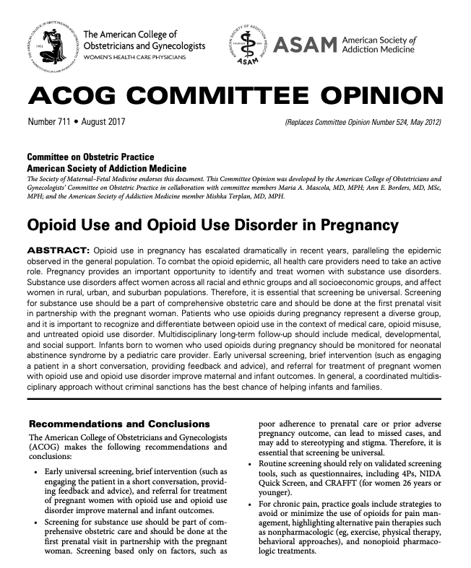
Background
Screening for substance use “is a part of complete obstetric care and should be done in partnership with the pregnant woman…”
“Routine screening should rely on validated screening tools…”
https://www.acog.org/clinical/clinical-guidance/committee-opinion/articles/2017/08/opioid-use-and-opioid-use-disorder-in-pregnancy

Slide 3
Universal Screening
Substance use disorders occur in every socioeconomic class, and racial and ethnic group
Recommended by:
- ACOG - ASAM
- AAP - CDC
Screen at the first prenatal
visit (at least)
Wright T et al., AJOG 2016
ACOG CO Number 711, August 2017
Notes:
Screening for substance use should be part of comprehensive obstetric care and should be done at the first prenatal visit in partnership with the pregnant patient.
Screening based only on factors, such as poor adherence to prenatal care or prior adverse pregnancy outcome, can lead to missed cases, and may add to stereotyping and stigma. Therefore, it is essential that screening be universal.

Slide 4
Why not universal TESTING?
False positives are a common
Particularly immunoassays
Narrow detection window
Legal implications
25 states + DC consider substance use during pregnancy child abuse
3 states consider it grounds for civil
SAMSA, Prevention of substance abuse and mental illness 2014. https://SAMHSA.gov/prevention
Guttmach Institute: https://www.guttmacher.org/state-policy/explore/substance-use-during-pregnancy#
Notes:
Limitations of biologic testing
•Short detection window: •Limitations associated with the half-life of substances and metabolic clearance rates •No standardization what cutoffs should be used for assays •Does not capture binge, intermittent or alcohol use
•False negative results -fentanyl, carfentanil, rohypnol, ketamine, MDMA
•False positive results –poppy seeds, pseudoephedrine
Obstetric care providers should protect patient autonomy, confidentiality, and the integrity of the patient–physician relationship to the extent allowable by laws regarding disclosure of substance use disorder.
Minnesota, South Dakota and Wisconsin substance use are grounds for civil commitment

Slide 5
Screening Tools
Tobacco, Alcohol, Prescription Medication and other Substances (TAPS) – formerly NIDA Quick Screen
4Ps: Parents, Partner, Past, Pregnancy
SURP-P: 3-item
CRAFFT: Car, Relax, Alone, Forget, Family/Friends, Trouble
Notes:
Routine screening should rely on validated screening tools, such as questionnaires including TAPS, 4Ps, SURP-P, and CRAFFT (for women 26 years or younger).
These tools have been well studied and demonstrate high sensitivity for detecting substance use and misuse. They can be used in direct interview format by physicians as well as nonphysicians and can be streamlined into clinical practice by using computer-based approaches.

Slide 6
What to do after screening
Screening
Brief Intervention
Referral to
Treatment
Notes:
Screening—A health care professional assesses a patient for risky substance use behaviors using standardized screening tools. Screening can occur in any health care setting.
Brief Intervention—A health care professional engages a patient showing risky substance use behaviors in a short conversation, providing feedback and advice.
Referral to Treatment—A health care professional provides a referral to brief therapy or additional treatment to patients who screen in need of additional services.

Slide 7
Brief Assessment
Brief assessment of positive screen:
What specific substances have you been using in the past 3 months? During this pregnancy?
How much of each substance at a time?
How frequent?
How does this affect your life (job, home life, self-care, health, emotions)?
Notes:
The Tobacco, Alcohol, Prescription Medication and other Substances (TAPS)
Use screen to stratify risk

Slide 8
Use Brief Assessment to Stratify Level of Risk
LOW RISK
Use Brief Assessment to Stratify Level of Risk
No current use
Minimum past use and stopped for pregnancy
Educate regarding recommendations to avoid substances
Encourage the patient to ask for help in the future if needed
MODERATE RISK
History of high use
History of past treatment
Currently stable
Continues low level use at any point in pregnancy
Brief intervention
Monitor – repeat screen
HIGH RISK
Current use
active
Refer to SUD treatment
Wright, TE., et al. AJOG 215(5) (2016): 539-547.
Notes:
The Tobacco, Alcohol, Prescription Medication and other Substances (TAPS)
Use screen to stratify risk

Slide 9
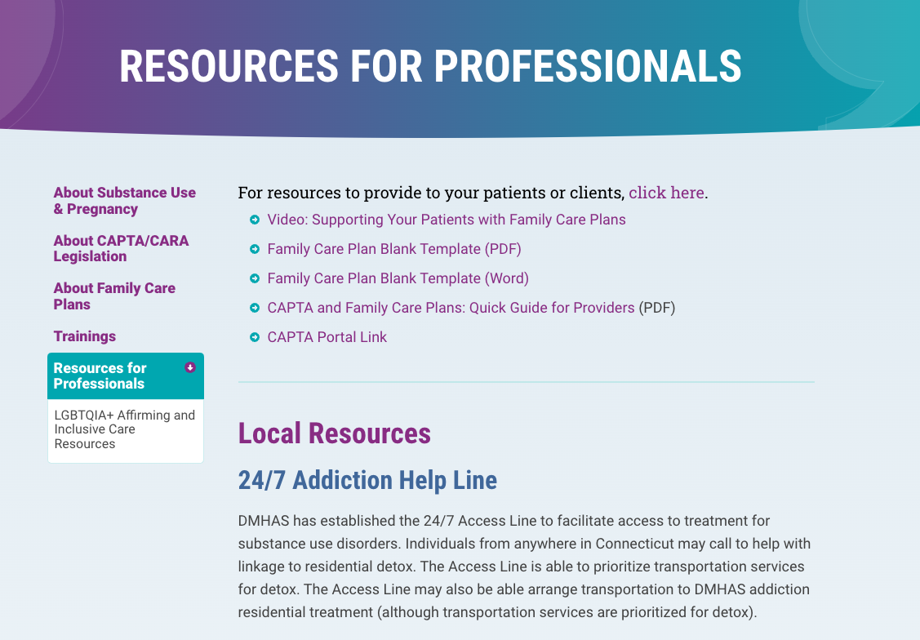
Family Care Plan
https://www.sepict.org/professionals/resources-for-professionals/

Slide 10
How do I refer?
Call ACCESS Mental Health for Moms!
Monday – Friday from 9am – 5pm
Toll-free 833-978-MOMS (6667)

