Slide 1
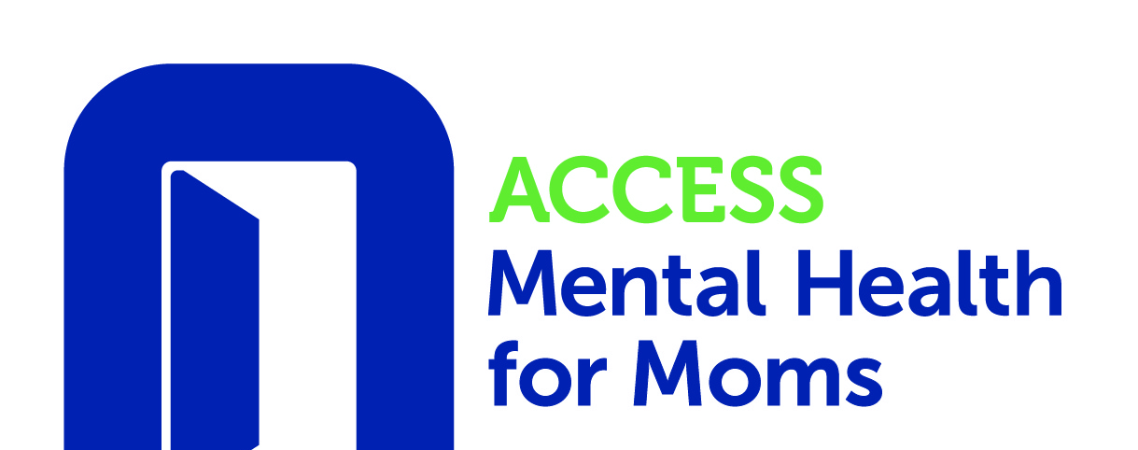
Screening Tools for Substance Use in Pregnancy: TAPS
Ariadna Forray, MD

Slide 2
Tobacco, Alcohol, Prescription medication, and other Substance use (TAPS)
TAPS-1 - 4-item screen for tobacco, alcohol, illicit drugs, and non-medical use of prescription drugs
TAPS-2 - brief assessment for those who screen positive to any substance in TAPS-1
May be either self-administered directly by the patient or as an interview by a health professional
Uses an electronic format (available as an online tool: https://nida.nih.gov/taps2/)
Uses a screening component to ask about frequency of substance use in the past 12 months

Slide 3
TAPS-1

Slide 4
TAPS-2
Asks about use in past 3 months of any substance screened positive on TAPS-1
Notes:
The TAPS tool starts with questions about the frequency of use of tobacco, alcohol, and other substances in the past 12 months. Endorsement of any substance use during the initial screening phase (TAPS-1) prompts few additional questions regarding use-related behaviors through a brief assessment (TAPS-2).

Slide 5
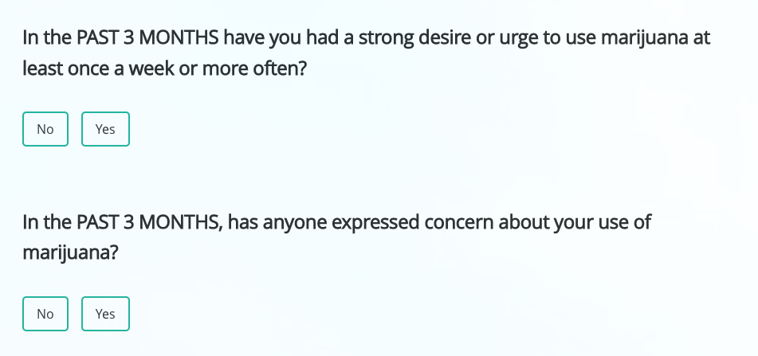
TAPS-2: Positive Use in Past 3 months
If positive use in past 3 months of additional questions related to use behavior

Slide 6
TAPS-2: Risk Category
TAPS Score | Risk Category
0 | No Use in Past 3 Months
1 | Problem Use
2+ | Higher Risk
Notes:
Scores on these questions generate a risk level per substance endorsed, based on a range of possible scores per substance.
For identifying DSM-5 SUD at the recommended cutoff of 2+, the TAPS Tool has adequate sensitivity (>70%) only for tobacco, alcohol, and marijuana. Further assessment should be conducted for patients with a score of 1+ for other substances. This assessment is a high priority for patients with a TAPS score of 2+, given its high positive predictive value for most substance classes.

Slide 7
How do I refer?
Call ACCESS Mental Health for Moms!
Monday – Friday from 9am – 5pm
Toll-free 833-978-MOMS (6667)

