Slide 1
Some Tips for Helping Families Cope with Traumatic Events
Self Care- Breath, be self aware, be/act calm
Remind your children they are safe
Share news as to what happened, let them hear it from you first, while reassuring their safety
Manage the Media, limit exposure to news coverage
Listen, reassure, answer questions honestly
Schools are already planning on how to support kids and families
Maintain routines- yup, back school, in person or distance
Plan fun activities

Slide 2
SOME RESOURCES – Coping with Traumatic Events
NCTSN.org
AACAP.org
Facts for Families
Terrorism and War: how to talk to children
Child Mind Institute
Helping Children Cope After A Traumatic Even
ACCESS MENTAL HEALTH CT

Slide 3
Management of ADHD with Poor Response to Initial Treatment, Comorbid Anxiety, Depression or Disruptive Behavior.
Richard J. Miller, MD, FAACAP
Hub Medical Director, ACCESS-Mental Health CT
Medical Director, Children’s Services
Wheeler Clinic

Slide 4
Disclosure
Richard J. Miller, MD, FAACAP
Financial disclosure: contract with ACCESS Mental Health CT
No commercial conflicts of interest
Off-label use of medications may be discussed

Slide 5
Learning Objectives
After attending this session, the participants will be able to:
Describe some of the different causes of poor response to initial treatment for ADHD.
Outline strategies for primary care providers to approach assessment and treatment for patients whose outcome is complicated by poor response to initial treatment or co morbid conditions.
Guide families through decision-making process regarding treatment options

Slide 6
“Prerequisites”
This talk was developed for practitioners who are already comfortable with the initial evaluation and treatment of ADHD in the primary care settings.
It is assumed the clinician is familiar with and has experience prescribing approved medication for ADHD including Stimulants (Methylphenidate and Amphetamine), Alpha Agonists (Clonidine and Guanfacine) and Atomoxetine.
However, we will start with a very brief review of ADHD 101”
We will not be discussing nonpharmacological interventions, which are the first initial treatment of choice.

Slide 7
ADHD Criteria: DSM 5 same as DSM IV TR
Inattention
Careless/inattention to detail
Problem concentrating
Doesn’t seem to listen
Doesn’t finish tasks
Difficulty organizing
Avoids tasks requiring sustained effort
Loses important items
Easily distracted
Forgetful
Hyperactivity/Impulsivity
Squirms/fidgets
Can’t stay seated
Runs/climbs excessively
Can’t work/play quietly
“Driven by a motor”
Talks excessively
Blurts out answers
Can’t wait turn
Intrudes/Interrupts
Inappropriate for developmental level; significant impairment; two or more settings; not otherwise explained

Slide 8
DSM 5: PRESENTATIONS not “subtypes”
Distinction found between inattention (IA) and Hyperactive/Impulsivity at time of assessment but does not hold true over time
New specifiers: PRESENTATIONS
Hyperactive-impulsive presentation (6 or more hyperactive-impulsive symptoms but 5 or fewer inattentive symptoms)
Inattentive presentation (6 or more inattentive symptoms but 5 or fewer hyperactive-impulsive)
Combined presentation (6 or more of each set)
Other specified and Unspecified

Slide 9
Evaluation of AD/HD
ADHD IS A CLINICAL DIAGNOSIS
Diagnosis requires:
Comprehensive history
Interview with parent and child
Physical examination
Information from school
Rating scales (Vanderbilt, Conners, Etc.
Check for other problems that look like AD/HD or come with it*
Goal: Understand THIS child; establish working relationships with parents, child and school

Slide 10
Assessment Visit
Interview of caregivers and CHILD (separately if possible)
Obtain Pertinent Targeted History including
Onset and pattern of development of symptoms
How it presents in different settings
Sleep and Screen habits
What patient and family have tried before
Family history of ADHD, Anxiety, Bipolar disorder, psychosis, suicidal behavior, trauma or substance abuse
History of stressful events
Ask about anxiety, depression, substance abuse, suicidal self or other injurious ideation or behavior.
Medications, caffeine, herbal supplements, nicotine and substance use
Review reports and rating scales
Notes:
Can give some details of questions/ topics for interview.

Slide 11
Assessment Strategies for ADHD
USE RATING SCALES
Vanderbilt Parent and Teacher ADHD Scales
Connor’s Parent and Teacher ADHD Scales
Note that Vanderbilt scales also include screens for co-morbid conditions such as anxiety, and behavioral disturbances as well as impairment indicators)
Obtain info from School
School rating scales
School based Assessment including psycho-educational testing
Obtain Other Collateral Information
Develop and Utilize “OBSERVER FORMS” to collect observations from different caretakers and collaterals (or use our forms)
Notes:
Add details for packets and tools
AAP guidelines now include requiring documentation of impairment.
Also Vanderbilt f/u scales include medication side effect screening questions.

Slide 12
American Academy of Pediatrics Clinical Practice Guideline for ADHD in Children and Adolescents - update
Revised in 2011 and again 10/2019
Expanded age ranges: 4 - 18 from 6-12
Discussion treatment approaches for different age groups
ADHD Clinical Practice Guideline: Implementing the Key Action Statements —An Algorithm and Explanation for Process of Care for the Evaluation, Diagnosis, Treatment and Monitoring of ADHD in Children and Adolescents
https://pediatrics.aappublications.org/content/144/4/e20192528

Slide 13
Office Based Non-Medical Interventions
Provide education about ADHD (Child & Family)
Office based therapy approaches
Supportive counseling
Family Counseling
empowering parents
behavioral approaches
the importance of providing structure in home

Slide 14
Non-Pharmacological Interventions:
Mental Health Centers/Outpatient Therapy
Behavioral Therapy
Parent Behavior Management Therapy
Neurofeedback
Parent Support Groups
School-system
Establish collaborative COMMUNICATION
School-based assessment
Accommodations and specialized services
Counseling-individual and group
Notes:
Biofeedback now covered by most insurance

Slide 15
Medication Based Treatment
Primary Care Providers
Psychopharmacology (Psychostimulants and Non-stimulants)
Treatment monitoring and case management
AMHCT is here to help PCP and Family with Referrals
Assessment with recommendations
Assessment and treatment
Referral Providers/Specialists
Psychiatry
Psychiatric Nurse Practitioners
Developmental-Behavioral Pediatrics (if available)\
Behavioral Neurologists
Notes:
Tx monitoring: reassurance following up on progress in other settings and treatments.

Slide 16
Management of Poor Response or Adverse Effects of Medication
It’s helpful to know the tools in the toolbox.
Although we are assuming you are familiar with ADHD medications and dosing. Let’s take a moment to review the similarities and differences of the available medication options
We will focus on principles and helpful concepts rather than dosing. “How to cook vs giving recipes”

Slide 17
FDA Approved Medications for ADHD
FDA Approved
Stimulants
Methylphenidate
Amphetamine
Non-Stimulants
Alpha Adrenergic Agonists
Clonidine
Guanfacine
(ER approved IR not approved)
Antidepressant Related
Atomoxetine

Slide 18
Non-FDA Approved Medications
Antidepressants
Bupropion
TCAs (imipramine, desipramine, nortriptyline)
Narcolepsy Medications
Modafinil (Dopamine reuptake inhibitor)
Armodafinil
Solriamfetol??? (“Sunosi”) (dopamine and Norepi reuptake inhibitor)
Recently approved for narcolepsy & daytime somnolence.
No Data yet
Other:
Amantadine

Slide 19
Psychostimulant Medications
All stimulants used in the USA are either Methylphenidate or Amphetamine derivatives.
Methylphenidate and Amphetamines both inhibit norepinephrine and dopamine transporter functioning, which acts to increase central dopamine and norepinephrine activity which improves attention and executive functioning*
However, there are some differences for example Amphetamine also inhibits Monoamine Oxidase activity and has some pre-synaptic intracellular activity. As such it may have greater potency affecting benefit and adverse effects.
Notes:
Why does this work
Noradrenergic
Dopaminergic

Slide 20
Easy, Only two medicines to choose from
No such luck

Slide 21
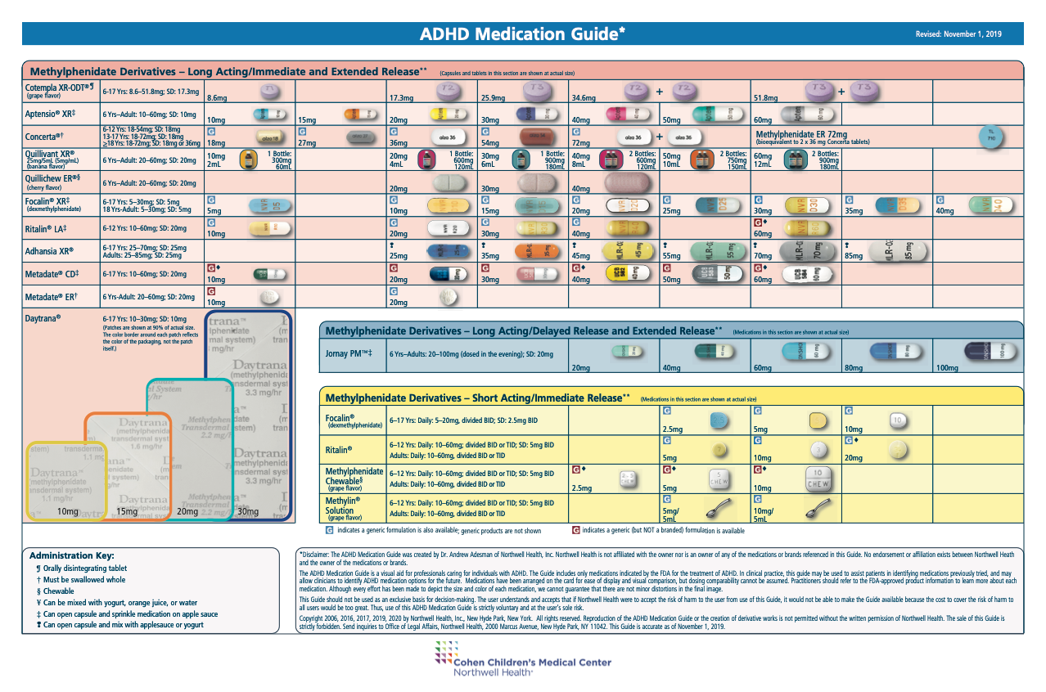

Slide 22
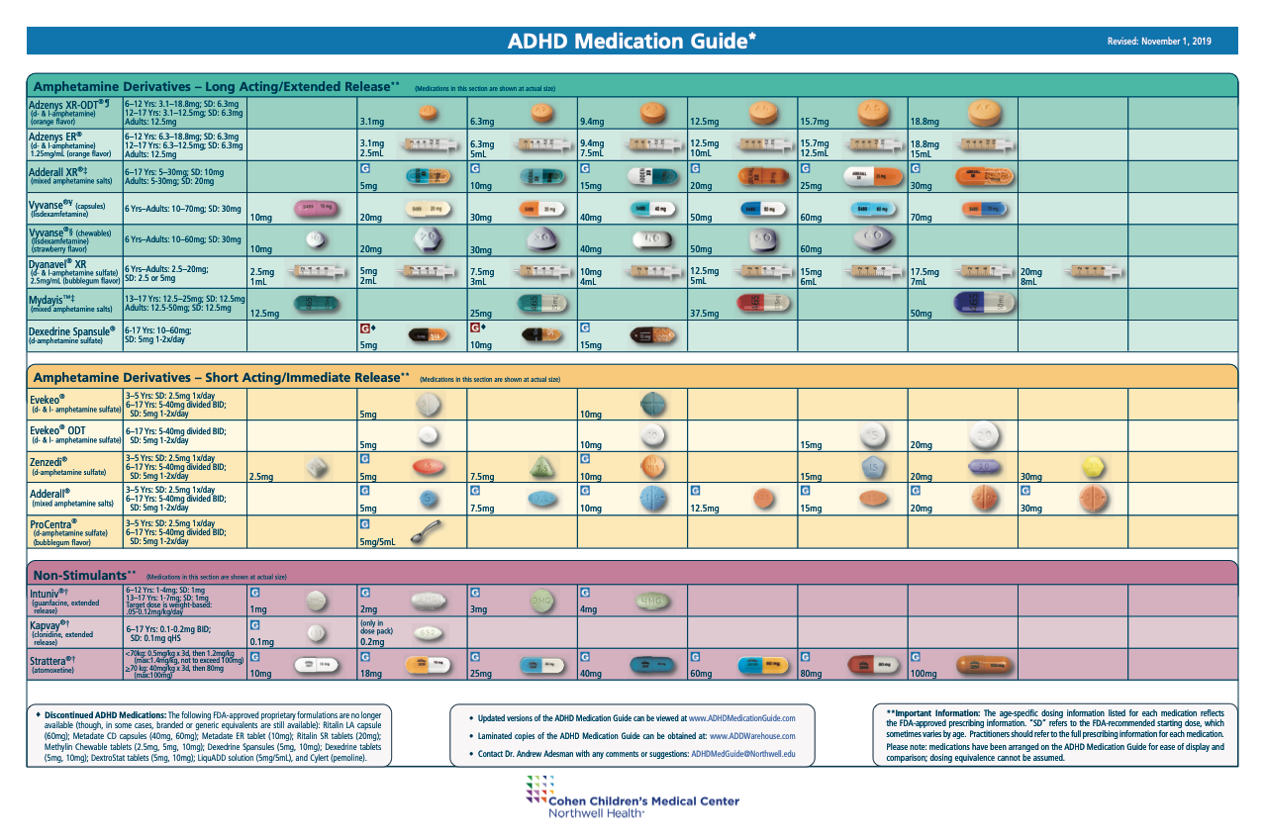

Slide 23
Why so many? What’s the difference
Stimulants have some idiosyncratic Pharmacokinetic and Pharmacodynamic properties
IR is very short acting (2-4 hour)
Stimulants have somewhat different effects when blood level is increasing vs decreasing
Maximum benefit occurs while the blood level is slowly increasing
Adverse effects can be different at onset, peak and offset.
Therefore, dosage curve is very important and varies with medication and preparation
Ex. insomnia can be caused by rebound or extended duration

Slide 24
“It’s All About the Curve”
The Ideal Dosage Curve
Rapid Onset, followed by slow increase and gradual offset
Sufficient duration of action of benefit (might be shorter for elementary school student but longer for high schooler)
Ideally once a day administration
Minimum adverse effects
Dosage response curve varies with different preparations and individual’s (pharmacokinetics and pharmacodynamic differences)

Slide 25
DOSE CURVE -Immediate Release stimulant Individual Response
EFFECTIVE ZONE
8 AM
12 PM
4 PM
8 PM
Notes:
J

Slide 26
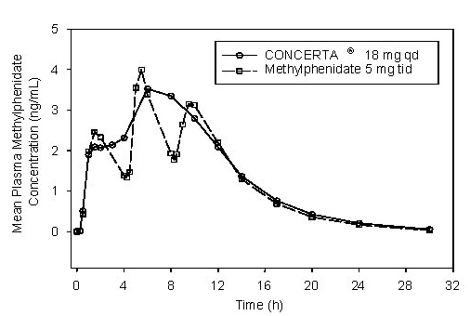
Dosage Curve – Extended Release
“Concerta” vs immediate release MPH
From Package Insert

Slide 27
OROS Methylphenidate aka Concerta®
Notes:
Concerta is the most commonly prescribed medication to teens in the United States. When the product first hit the market in 2000, it revolutionized the treatment of ADHD because Concerta offered the first truly effective method for prolonging the effects of methylphenidate (the active ingredient in Ritalin and many other stimulant preparations) so that kids no longer needed to go to the principal’s office or nurses’ office in the middle of the school day. When Adderall XR followed in 2001 and Strattera in 2002, a vast increase ensued in the number of children and teens identified with and treated for ADHD. Out of the roughly 25 medications approved for ADHD, Concerta remained very popular because of the consistency of its’ effects throughout the school day into the time immediately following school. It is widely used in teenagers because of its’ beneficial effects on driving performance.
Concerta utilizes something called the OROS delivery system (see featured picture at the top of this blog post) to release methylphenidate into the body. It was developed by a team of scientists in California who observed a phenomena referred to as “tachyphylaxis” with earlier attempts to develop long-acting methylphenidate-based stimulants. Essentially, people taking stimulants develop some degree of tolerance to the drug acutely in response to an individual dose. While the absolute level of the drug in someone’s system matters, whether the blood level is rising or falling also matters, since a rising blood level contributes to the ability of a stimulant to sustain beneficial effects over the course of a school or work day.
Concerta was designed to release an initial dose of stimulant within the first two hours of ingestion…22% of the active drug is contained within the coating of the pill. After this overcoat dissolves, a laser-drilled hole in the end of pill is uncovered. As the pill passes through the stomach and the gastrointestinal track, water taken up into the pill results in changes in internal pressure that leads to a “pulse release” of small amounts of medication as it passes through the gut. The effects of Concerta were tested in a laboratory classroom setting, in which raters blinded to whether kids received active drug or placebo scored the observable behavior of kids throughout a twelve hour day, and an age-appropriate mini-math test (PERMP) was administered at intervals throughout the day to measure the effects of medication on cognitive performance. The results are pictured below. A significant benefit of Concerta is the consistency of improvement in cognitive performance throughout the day.

Slide 28
Bead Technology e.g. Adderall XR ®

Slide 29
Why so many? What’s the Difference?
First be familiar with the differences
Primary ingredient (MPH vs AMP)
Racemic vs Mono isomer (ex MPH vs d-MPH or Dex vs MAS)
Immediate release vs Extended
Type of Extended release (OROS, beads, multi-layer tablet etc.)
Administration form
(Capsule, Tablet, Chewable, ODT, Concentrate, Patch)
Generic vs Brand

Slide 30
Dexmethylphenidate: Focalin® and Focalin XR ®
Methylphenidate is racemic mixture with both dextro (right twisted) and levo (left twist) molecules
Only right-handed is active
Both can contribute to side effects
Focalin® uses ½ the dose of MPH
May have clinically lower intensity of SE
Slightly longer acting
Slightly different “quality”
Brams M 2012
Notes:
J Clin Psychopharmacol. 2012 Oct;32(5):637-44. doi: 10.1097/JCP.0b013e3182677825.
A randomized, double-blind study of 30 versus 20 mg dexmethylphenidate extended-release in children with attention-deficit/hyperactivity disorder: late-day symptom control.
Brams M, Turnbow J, Pestreich L, Giblin J, Childress A, McCague K, Muniz R.
Source
Menninger Department of Psychiatry, Baylor College of Medicine, Houston, TX 77007, USA. drmattbrams@aol.com
Abstract
The objective of this study was to evaluate the safety and efficacy of dexmethylphenidate extended-release (d-MPH-ER) 30 versus 20 mg in children with attention-deficit/hyperactivity disorder (ADHD) in a 12-hour laboratory classroom setting. In a randomized, double-blind, 3-period × 3-treatment, crossover study, children aged 6 to 12 years with Diagnostic and Statistical Manual of Mental Disorders, Fourth Edition-diagnosed ADHD previously stabilized on MPH (40-60 mg/d) or D-MPH (20-30 mg/d) were randomized to receive D-MPH-ER 20 mg/d, 30 mg/d, or placebo for 7 days each. Primary efficacy measurements were change in the average SKAMP (Swanson, Kotkin, Agler, M-Flynn, and Pelham)-Combined score from predose to 10, 11, and 12 hours postdose [Avg(10-12)] between 30 and 20 mg D-MPH-ER. Safety was assessed by adverse events, vital sign monitoring, and electrocardiograms. A total of 165 children were randomized, and 162 were included in the intent-to-treat analysis. Mean Avg(10-12) change from predose in SKAMP-Combined score was significantly greater for D-MPH-ER 30 mg (-4.47) compared with D-MPH-ER 20 mg (-2.02; P = 0.002). Most common adverse events (≥ 3% in any group) were decreased appetite (6.1%, 4.9%, and 0%), headache (4.3%, 4.3%, and 1.9%), abdominal pain (3.7%, 3.1%, and 3.1%), and tachycardia (1.2%, 3.1%, and 0.6%) for D-MPH-ER 30 mg, D-MPH-ER 20 mg, and placebo, respectively). Significantly greater improvement in ADHD symptoms was noted with D-MPH-ER 30 mg compared with D-MPH-ER 20 mg at hours 10 through 12. Tolerability was comparable between doses. Dexmethylphenidate extended-release 30-mg dose may provide further benefit to patients who do not maintain optimal symptom control later in the day with D-MPH-ER 20 mg.

Slide 31
KEY Stimulant References to have on hand.
NORTHWELL HEALTH MEDICATION GUIDE
http://www.adhdmedicationguide.com
New Formulations of Stimulants: An Update for Clinicians
R.Steingard et Al. J of Child and Adolescent Psychopharmacology V29,Number 5, 2019 pp324-339
Has very practical tables of grouped by ingredient and duration of action listing ingredients, dosing and mechanism.
As well as equivalencies.

Slide 32
Non Stimulants: Alpha Agonists
Alpha Adrenergic Agonists:
Clonidine, Clonidine ER (“Kapvay”), clonidine patch.
Guanfacine, Guanfacine ER (“Intuniv”)

Slide 33
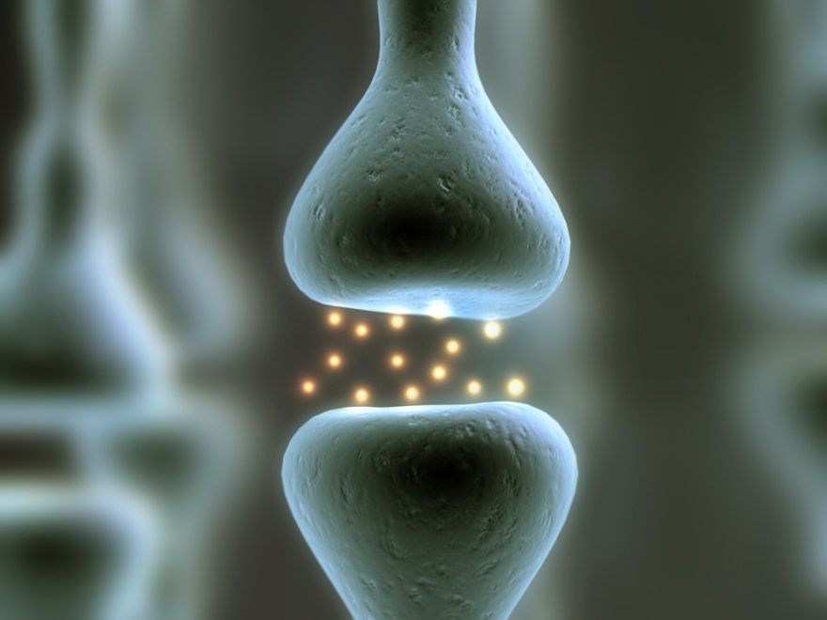
Adrenaline/Noradrenaline system
Locus Coeruleus
Amplifies ALERT signal
Alpha 2 receptors
auto-receptors post synaptic
Measure and adjust amt in synapse
Alpha 2 agonists trick nerve into thinking too much in synapse
Message takes a few days to get to cell body
Down-regulates
Kollins SH 2011
Notes:
Alpha agonists
from: CHILD PHARMACOLOGY LIST-SERV <Child-Pharm@googlegroups.com>
The adrenaline/noradrenaline system is the smallest in the human nervous system. It consists of only one nucleus, the locus coeruleus, and 95% of the approximately 10,000 nerve cells that use noradrenaline either start or end at the Coeruleus. Each adrenaline nerve , however, has a big but nonspecific effect since each has about a half million dendritic projections. Think of it as a huge amplifier that multiplies a signal 500,000 times in an alerting fight/flight response.
The alpha 2 receptors are auto-receptors; that is, they measure the amount of noradrenaline that is in the synapse and then regulate the amount that is produced by the cell accordingly. The two alpha agonists activate these receptors and trick the nerve into thinking that there is way too much adrenaline being released out at the synapse. The message to slow down the production of neurotransmitters takes a few days to get back to the cell body. The adrenaline that has already been sent out the dendrite takes a few days to get there. This, I am told, is why it takes 5 to 7 days after changing the dose of an -----alpha agonist to see the therapeutic result.

Slide 34
Alpha Agonists - Indications
Alpha Adrenoreceptor agonist, post-synaptic
Prefrontal cortex
Increases delay-related firing PFC neurons
Severe hyperactivity / impulsivity
Aggression / ODD / Over-reactivity
Tics
ADHD with motor tics
ADHD with atypical features (irritability)
Sleep onset problems

Slide 35
DOSE CURVE -Alpha Agonists
Clonidine about 6 to 8 hours
Guanfacine about 12 hours
EFFECTIVE ZONE
Steady state medication-doesn’t wash-out like stimulants
0
8 AM
12 PM
4 PM
8 PM

Slide 36
Clonidine (Catapres®)
Alpha noradrenergic agonist
Indications: ADHD, aggression, irritability, tics
Dosing: 0.05 to 2.0 mg ~ 1 hour before bedtime
If used for sleep onset may wear off ~ 4 AM
Titrate up slowly and administer daily for monotherapy
May need TID or even QID dosing if monotherapy
3 - 6 weeks to determine benefit for ADHD
Less helpful with inattention than stimulants
Side effects: sedation, headaches, depression, hypotension, rebound hypertension [wean off gradually]
Adjunctive medication with stimulant
Catapres® patch (change every FIVE days)
*

Slide 37
Clonidine Extended Release – Kapvay ®
FDA approved (2010 monotherapy; 2013 adjunctive)
0.1 mg, 0.2 mg tablets (must take whole)
Twice daily dosing
Lower peak concentration than IR, less sedating
Indications: not first line; ADHD; tics; irritable/oppositional profile; side effects with stimulants; need for adjunctive therapy due to stimulant-related anorexia;
Side effects: sedation, hypotension, psychiatric

Slide 38
Guanfacine (Tenex®)
Alpha 2a noradrenergic agonist (more selective)
Dosing: 0.5 to 2.0 mg up to TID
Longer half-life usually BID
Administer DAILY
Better effect on attention than clonidine
Less sedation than clonidine
Improvement ADHD Sx including some attention effects
SE: insomnia, agitation, headaches
*

Slide 39
Guanfacine Extended Release (Intuniv®)
Intuniv (long-acting guanfacine) November 2009
Alpha 2a adrenergic agonist
Tablet: 1, 2, 3 and 4 mg; q day dosing with 1 week between dosage changes
Main side effects: possible sedation, rebound hypertension if stopped abruptly
Smooth sustained release
Data suggest effective but not be as effective as stimulants
Approved as adjunctive medication
Kollins SH 2012

Slide 40
Atomoxetine (Strattera ®)
Approved by FDA in November 2002
Not controlled substance; low abuse potential
Highly selective norepinephrine reuptake inhibitor
Rapidly absorbed; not affected by food
Peak plasma concentrations 1-2 hrs. p dose
Hepatic cytochrome P450 2D6 pathway (~5% slow)
Prolonged duration reported, effects next AM or give at dinner if mornings are particularly difficult
Side effects: stomach upset, fatigue, agitation
Black box: suicidal ideation, mania, liver enzyme (RARE)
Notes:
Doesn’t stimulate P450
Poor metabolizes 19-20 hours
7% of Caucasians
2% of Blacks
One double blind study of slow metabolizer the slow metabolizer had poorer repose rate but no greater rate of adverse events
Ultra rapid metabolizers ~5% 1/2 life is 2-3 hrs.
Since reuptake inhibitor duration of action longer than 1/2 life Observed duration with once daily dose persist after drug is cleared and/or brain concentration may differ from plasma

Slide 41
Atomoxetine- Who am I using it for?
Response ~60 % (not stimulant naïve)
Children who failed at least 1 stimulant
ADHD with tics
ADHD with anxiety
ADHD with ASD
ADHD with substance abuse
ADHD with Dyslexia (+/-)
Consider it for:
Children with problems evening/ early AM
Children who need continuous med

Slide 42
Causes of Poor Response to Initial Treatment
Medication related issues
Poor compliance
Adverse effects
Non-response
Diagnosis or target symptom related issues
Misdiagnosis
Comorbid conditions

Slide 43
Adverse Effects of Stimulant Medication

Slide 44
Example of timing related adverse effects
Notes:
Give examples of some and how this can be addressed by adjustment of medication
Common mistake late onset of Concerta giving higher dose then getting peak adverse effects when adding small ir dose in am might improve onset and lower slow release eliminates peak adverse effects.
Switching between Ritalin IR, Focalin, XR and Metadate CD have different proportions of immediate and slow release.
Similarly Knowing difference between Dexedrine, Adderall XR and Vyvanse

Slide 45
Assessment of Adverse effects
Note the timing of the adverse reaction (and benefits)
Adverse effects that occur during onset, peak and “offset” can often be addressed by changing dosing, schedule or preparation
Adverse effects that occur without regard to timing may require changes in medication type, look for other contributing factors or reassessment of diagnosis (diet, sleep, screen time, Allergies)
Review compliance, weekends, households
Check for other medications, caffeine, nicotine, decongestants, nutritional supplements. (Recreational substances as well)
While adjusting dosage and response Pt must take on weekends so family can observe peak effects at home or if only occurring at school.
Notes:
Examples:
Problems with headache during onset vs peak vs offset. Monday morning headaches.
Mood issues during peak or all day long

Slide 46
Generics
No real difference with IR formulations
With Extended Release, how the tablet is made can vary with manufacturer and make significant difference.
Example: CONCERTA
What makes Concerta different is that is uses an OROS slow release system.
Newer Generics slipped though FDA approval with Non OROS slow release
After complaints, FDA rescinded Mallinckrodt and Kremers Urban Non OROS MPH ER as being Concerta Generic equivalents.
Write for Concerta and allow substitution do not write for MPH ER
Always check for change in generic when medication “stops working”

Slide 47
CONCERTA

Slide 48
Concerta Generics OROS ≠ Non OROS MPH ER
Notes:
Concerta utilizes something called the OROS delivery system (see featured picture at the top of this blog post) to release methylphenidate into the body. It was developed by a team of scientists in California who observed a phenomena referred to as “tachyphylaxis” with earlier attempts to develop long-acting methylphenidate-based stimulants. Essentially, people taking stimulants develop some degree of tolerance to the drug acutely in response to an individual dose. While the absolute level of the drug in someone’s system matters, whether the blood level is rising or falling also matters, since a rising blood level contributes to the ability of a stimulant to sustain beneficial effects over the course of a school or work day.
Concerta was designed to release an initial dose of stimulant within the first two hours of ingestion…22% of the active drug is contained within the coating of the pill. After this overcoat dissolves, a laser-drilled hole in the end of pill is uncovered. As the pill passes through the stomach and the gastrointestinal track, water taken up into the pill results in changes in internal pressure that leads to a “pulse release” of small amounts of medication as it passes through the gut.
Because Johnson & Johnson (the parent company that owns the rights to Concerta) owns the patent on the OROS release system, companies seeking to make a generic version had to do so with a different delivery system.
Ultimately, Watson Pharmaceuticals was approved to manufacture a generic equivalent of Concerta. As often occurs in these situations, the lawyers for Johnson & Johnson and Watson worked out a deal. J & J would continue to manufacture Concerta through their Alza subsidiary that Watson would sell at a discount as an “authorized generic,” with the two companies splitting the profits. The brand Concerta and the Watson/Activis version of Concerta are equivalent…they are manufactured in the same factory, using the same equipment and the same drug delivery system as in the original Concerta.
the Mallinkcroft product (pictured at right), an overcoat containing immediate-release methylphenidate that dissolves within the first hour after ingestion. The core of the pill contains a diffusion-controlling membrane that releases methylphenidate as water in the gastrointestinal tract passes through the membrane. The membrane is designed to release methylphenidate over a period of time roughly corresponding to the release period resulting from the OROS delivery system in Concerta.
Kremers Urban generic (pictured at right) uses an extended-release bead technology to release methylphenidate at a controlled rate. The pill resembles a conventional tablet in appearance, featuring an overcoat containing immediate release stimulant that releases during the first hour as the tablet disintegrates and a core of extended-release stimulant beads operating with a similar mechanism as those in Focalin XR.

Slide 49
Treatment of Common Adverse Effects - Appetite
Obtain baseline information on appetite and eating pattern
About 30-50% have some decrease in appetite for lunch;
Often Transient; decreases in 2 weeks
Monitor height and weight
PLAN for it and involve the child
Can be managed
Strategic eating: Breakfast, Planned Snacks( pre prepared), Divide and conquer dinner (half meal with family & save half for when medication wears off or before bed)
Increase caloric density
Switch stimulants; consider Atomoxetine, Alpha agonist
Combine lower dose of stimulant with Alpha agonist or Atomoxetine
Periactin (last resort)

Slide 50
Adverse Effects - Sleep
Ask about sleep behaviors at all visits
Obtain baseline sleep history including environment, evening routines in household, bedtime routines, screen/media use, caffeine & supplements. Ask how pattern varies day to day and changed over time.
Ask about what has been tried already.
Is it trouble going to bed, trouble falling asleep once in bed or waking at night
Increased sleep dysfunction in ADHD (5x)
Stimulants can also delay sleep onset or sleep onset issues may be due to rebound or even the return of ADHD symptoms when meds have worn off; Some children fall sleep better with some medication still active in their systems.
Is there an anxiety disorder or depression?

Slide 51
Treatment of Sleep
Educate child and family about sleep
Being able go to sleep is a learned behavior. A skill that must be practiced and takes time to achieve. If they have to be exhausted to fall asleep, they do not have the skill to self sooth and down regulate arousal.
“Sleep hygiene”- establish calm, consistent bedtime routines; Sleep environment. They may need direct assistance in establishing routines and skills.
Removal of electronics; screen light tricks brain
www.commonsensemedia.org
IOS and Android parental controls and 3r party apps
iCBT
Notes:
Assist by staying in room, reading or being read to, listening to calm music, books on tape.
Can build routine alternating with quiet alone time and quiet together time.

Slide 52
Treatment of sleep issues - Medication
As an adjunct, if necessary, to other interventions.
First check if due to med related issues , rebound, too high a dose or med wearing off. Can see different in sleep pattern on or off stimulant meds. (if rebound small hs dose might be considered!)
Massage, herbal teas, bedtime (low sugar) snack, warm milk, turkey (tryptophan)
Melatonin 1 to 6 mg 45-60 minutes before sleep. Dosage is not weight dependent and less is often better
Decreases sleep latency but doesn’t increase duration
Dietary supplement; not regulated; use same brand
Can be used chronically; well tolerated;
Use slow release if there is middle insomnia
Clonidine
0.05 mg (1/2 of 0.1 mg tab) 30 minutes prior to sleep
Additional side effects include sleep architecture changes such as vivid dreams and reduced REM
Can sometimes exacerbate middle insomnia (if you wake up as or after it is wearing off)

Slide 53
Other Common Adverse Effects
Stomachaches and headaches
Commonly occur during onset/absorption, 45 to 90 minutes
Address by giving with meals, changing slow release prep or dosage.
Queasiness; persistent; regular
Rebound
Increased irritability (easily bothered), dysphoria or increased activity level that occurs during “offset” as medication wears off and may last ½ to 2 hours.
Emotionality, dysphoric or flattened mood. Check pattern,
If during peak, onset or offset adjust dosage curve.
If occurs throughout day, adjust total dosage or change medication.

Slide 54
Causes of Poor Response to Treatment
Poor Compliance
Non-response due to poor absorption?
Occasionally happens, try different preparation. Daytrana patch bypasses the GI tract and first pass hepatic metabolism.
Consider initiating treatment with IR medication then switch to ER
Mis-diagnosis
Inattention and impulsivity are the “fevers of behavioral health.” Lots of things can interfere with Attention besides ADHD
“Missed-diagnosis”: Comorbid conditions are very common and can interfere with response to ADHD treatment unless identified and addressed.

Slide 55
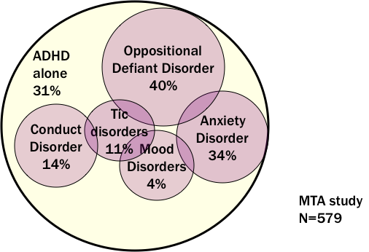
Common Comorbid Conditions
Miller, K 2015
Notes:
From KJM

Slide 56
Comorbid Conditions
Anxiety
Depression (more likely to be inattentive ADHD)
Bipolar disorder (especially if first showing up in mid teens)
DMDD
Disruptive Behavior Disorders (ODD, Conduct Disorder)
Tourette’s/Tic Disorders
Nicotine or other substance abuse
These common co-morbid conditions also can cause inattention or Impulsivity on their own without co-morbid ADHD

Slide 57
Misdiagnosis (Differential Diagnosis)
PTSD (arousal dysregulation and behavioral triggers may mimic ADHD but ADHD is also frequently co-morbid)
Inadequate sleep (insomnia, media use, etc.)
Environmental /school/ family stressors
Learning disabilities, especially language disorder
FAS
ASD (lack of shared goals/ focus) but there is also high comorbidity
Medical Conditions (Thyroid disorders, anemia, seizure disorders, pinworm etc.)
Caffeine, nicotine and herbal stimulants and energy drinks
Substance abuse (especially if turning up mid teens)
Notes:
Pinworms

Slide 58
What next?
REASSESS if there is a poor or unexpected response to initial treatment not clearly related to an adverse response to medication.
Review history. Focus on pattern of symptoms long term and day to day. when they started and how they evolved. Check for family history of comorbid or look alike conditions.
Interview with parent and child
Physical examination
Information from school and other collaterals
Rating scales Vanderbilt have screens for common comorbidities. PSC 17 or 35 are broader screens
Check more closely for other problems that look like ADHD or come with it
Goal: Understand THIS child; establish working relationships with parents, child and school

Slide 59
ANXIETY and PTSD
Anxiety has 10% -20% prevalence in children and up to 30% prevalence in teens and is Co- Morbid with ADHD in 1/3.
Anxiety can present with impaired concentration & restlessness.
ADHD medications can sometimes increase anxiety and occasionally cause anxiety like symptoms on their own.
Careful history (family history, presence and pattern of anxiety symptoms) screening tools (SCARED, Vanderbilt, PSC 17 will usually help clarify.
If co-morbid, stimulants can also occasionally improve anxiety, a careful trial can be helpful. If not treat Anxiety first with therapy and medication than reevaluate. Alpha agonists alone or in combination with stimulants can decrease anxiety related side effects and hyper-arousal, but do not directly treat anxiety.
Atomoxetine may address ADHD with less chance of exacerbating anxiety.
Referral and collaboration with mental health clinician is imperative

Slide 60
Post Traumatic Stress Disorder
Hyper-arousal, high reactivity and impulsivity are common in PTSD.
ADHD is also frequently co-morbid as well.
Kids with PTSD are often very sensitive to the adrenergic side effects of stimulants.
Alpha agonists are often very helpful alone or in combination with Stimulants as they down regulate arousal and block some of the adverse effects of the stimulants and act as an adjunct.
Notes:
Burning rubber analogy

Slide 61
Tourette’s and Tic Disorders
Impulsivity and hyperarousal are common in Tic disorders
Motor tics are common in childhood
Tics wax and wane.
Genetic factors important
50-60 % Tourette’s have ADHD, (25 % OCD)
Onset of ADHD Sx precedes onset of tics by 2 - 4 years
ADHD Sx often more disabling than tics
Treatment
Stimulants can either worsen or reduce tics. Start low, go slow.
Alpha agonists are first line for Tourette’s and 2nd line for ADHD
Atomoxetine has a reduced incidence of worsening tics

Slide 62
ODD and ADHD
Ongoing pattern of excessive anger-guided disobedience, hostile and defiant behavior toward authority
40% incidence of Co-morbidity with ADHD
ADHD increases risk of developing oppositional behavior
Once pattern begins, behavioral treatment is crucial for both parents and child
Even if there is a good response to stimulants it creates an increased opportunity to respond to behavioral and other therapeutic interventions.
Alpha agonists can sometimes be helpful alone or as adjunct to stimulants.
Carefully screen for co morbid conditions such as anxiety, depression, DMDD or Trauma/PTSD

Slide 63
Depression
5-10% incidence in Children and Adolescents
Mood disorders can be co morbid with ADHD
Impaired concentration, loss of interest and decreased effort can sometimes appear like Inattentive ADHD.
Screen with PHQ9
When Co-occurring both need treatment.
Wellbutrin can sometimes be used to treat ADHD as well as Depression

Slide 64
Bipolar Disorder
Episodic mood disorder with periods of depression, mania that are distinct from baseline and lasting a week or more
While episodes of depression are usually present, the presence of at least one distinct episodes of Mania must occur. It is not persistent reactivity irritability or mood instability
Impulsivity, impaired attention vary with mood episodes.
When ADHD does co-occur you can either stabilize moods first then address attention if it persists. However it is safe to cautiously treat attention with stimulant medication. Even without mood stabilizers.
This is a highly complex and severe disorder that usually requires multi-modal therapeutic interventions including complicated pharmacological treatment with SGAs and other mood stabilizers.

Slide 65
Other Comorbid Mood and Disruptive Disorders
DMDD (Disruptive Mood Dysregulation Disorder)
A pattern severe and recurrent temper outbursts that are grossly out of proportion in intensity or duration to the situation.
With persistently irritable or angry mood, most of the day and nearly every day
Behavioral and family treatment is primary. Optimal medication management is not yet clear but cautious trials of simulants +/- alpha agonists and or SSRI (especially if dysphoria is prominent). SGAs as well.
Look to co-morbid symptoms for treatment strategies
Intermittent Explosive Disorder
Discrete episodes of severe behavioral outbursts with return to normal mood in between episodes
Alpha agonists
Substance abuse: Assess and treat first. Do not treat attentional side effects of substance abuse. Use with caution consider Atomoxetine, Concerta or Vyvanse with close monitoring.

Slide 66
Severe Aggressive Outbursts
TOSCA* (Treatment Of Severe Childhood Aggression)
Looked at the treatment of with ADHD and severe co-morbid aggression (due to various causes)
Looked at treatment with parent training, Stimulants (MPH) and SGA (Risperidone)
Bottom line was parent training + MPH + Risperidone had a significant improvement with added SGA for “hot” or reactive aggression outbursts but not “cold” or proactive aggression (where aggression is in anticipation of a reward).
*Aman Et LA JAACAP 2014;53

Slide 67
Treatment: Family-Based
Psych education about ADHD and comorbidity (Child & Family)
Therapy approaches
Supportive counseling
Parent Behavioral Management Training or similar behavioral training
Family therapy – empowering parent, structure in home
Accessing treatment
Insurance
ACCESS Mental Health CT

Slide 68
Treatment: Community-Based
Mental Health Centers/Outpatient Therapy
Behavioral Therapy
Group, Family and Intensive Therapy programs
Neurofeedback
Parent Support Groups
School-system
Establish collaborative COMMUNICATION
School-based assessment
Accommodations and specialized services
Counseling-individual and group
Notes:
Biofeedback now covered by most insurance

Slide 69
Treatment: Medical Provider-Based
Primary Care Providers
Psychopharmacology (Psychostimulants and Non-stimulants)
Treatment monitoring and case management
Referral Providers
Psychiatry
Psychiatric Nurse Practitioners
Developmental-Behavioral Pediatrics (if available)
Referral services
Assessment with recommendations
Assessment and treatment
Notes:
Tx monitoring: reassurance following up on progress in other settings and treatments.

Slide 70
Practice Change to Consider
Be aware and think about co-morbid conditions
Be familiar with the differences between ADHD medications and how to switch between them or combine.
“Practice Readiness” (AAP Mental Health Task Force)
Parent and School Packets
Behavioral Health Screening tools
Broad based screens to check for co morbid conditions followed by more specific screening tools where indicated.
Identify resources in your community
Prepare handouts ready to give out.
ACCESS Mental Health CT
Notes:
Practice readiness is a term that aap met as way of getting your office practice ready to more effectively handle these situations.
If you can incorporate systems changes it can be more efficient than responding on a case to case basis.

Slide 71
Other resources.
AACAP Facts for Family
AACAP Resource Centers
AAP Mental Health Toolkit
www.healthychildren.org (AAP website for families)
www.schoolpsychiatry.org
www.parentsmedguide.org
ACCESS MENTAL HEALTH CT 866-631-9835

Slide 72
Resources:
NORTHWELL HEALTH MEDICATION GUIDE
http://www.adhdmedicationguide.com
New Formulations of Stimulants: An Update for Clinicians
R.Steingard et Al. J of Child and Adolescent Psychopharmacology V29,Number 5, 2019 pp324-339
ADHD Clinical Practice Guideline: Implementing the Key Action Statements —An Algorithm and Explanation for Process of Care for the Evaluation, Diagnosis, Treatment and Monitoring of ADHD in Children and Adolescents
https://pediatrics.aappublications.org/content/144/4/e20192528
Dr Millers ADHD Medication Table
Wheeler ACCESS MH 855-631-9835
JCordova@wheelerclinic.org,

